Slide 1








Slide 2
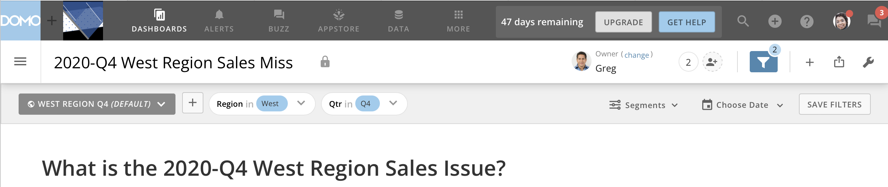
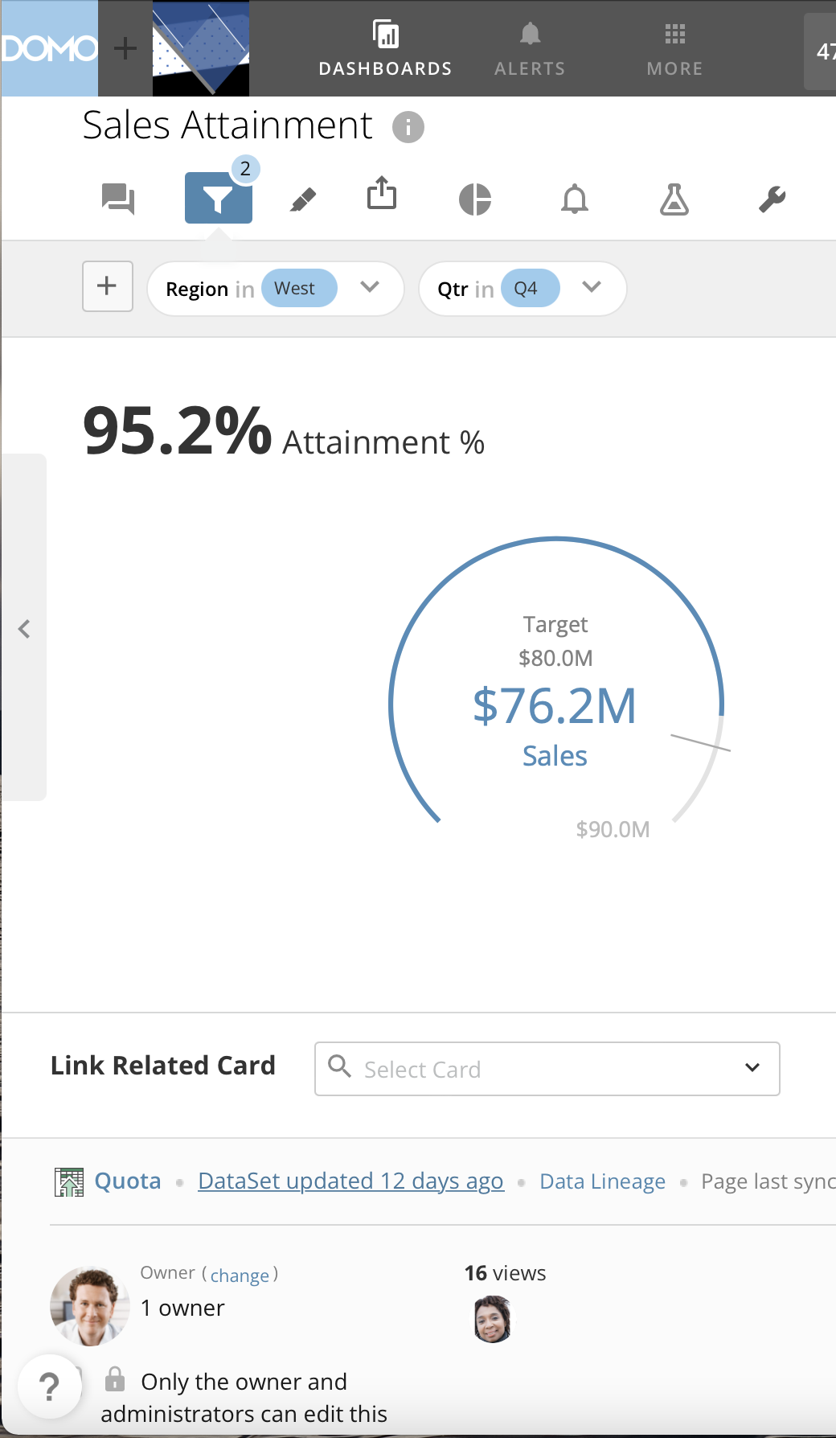
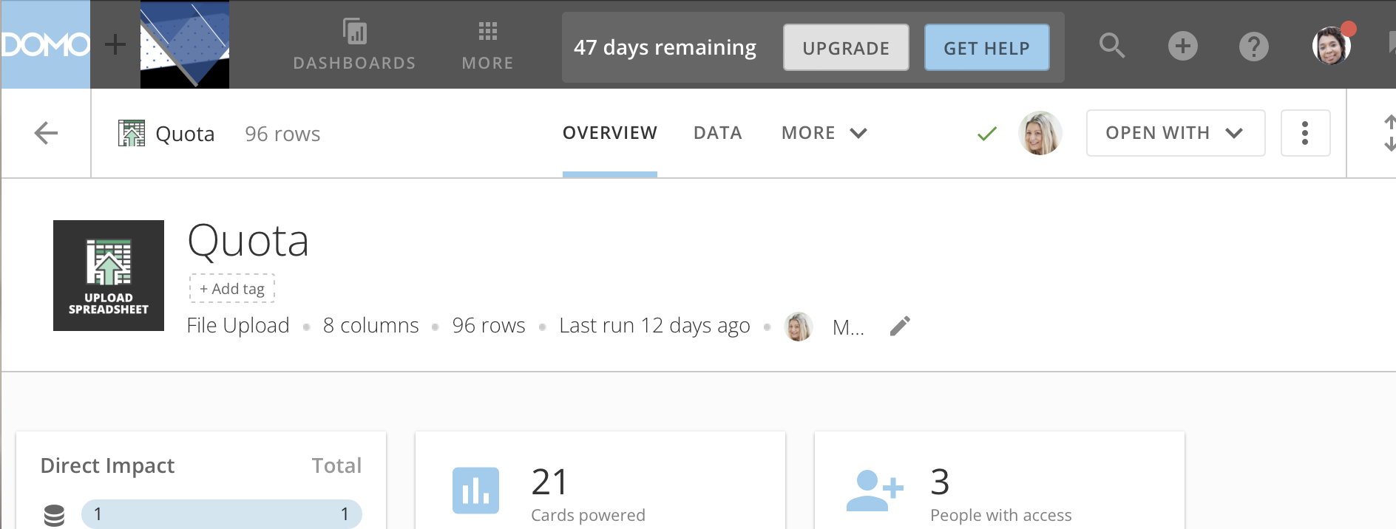
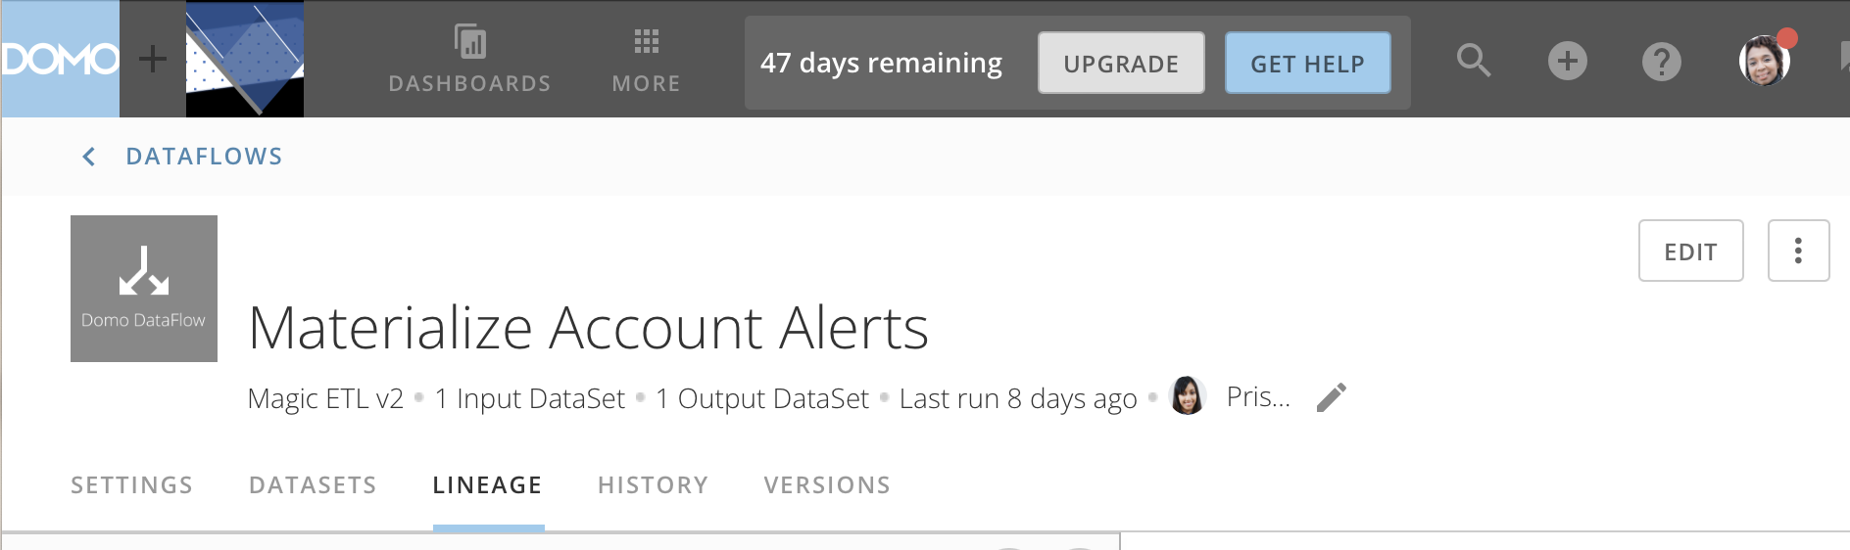
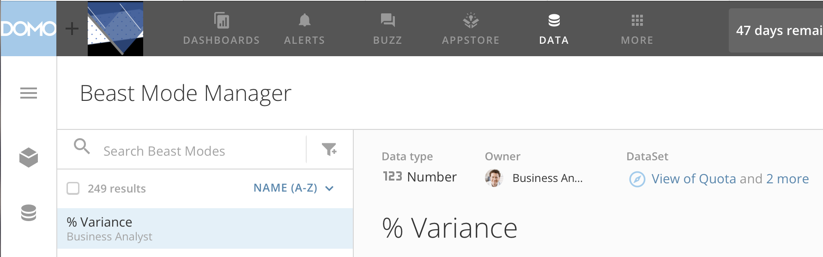
Page
DataSet
Card
DataFlow
Beast Mode

Slide 3
 |  | ROLE
 |  | Executive | Business Analyst | Major Domo | Data Specialist | Certification
ARTIFACT | Page | O
 | Card |  | O |  |  | O
 | DataSet |  |  | O | O | O
 | DataFlow |  |  | O | O
 | Beast Mode |  | O

Slide 4
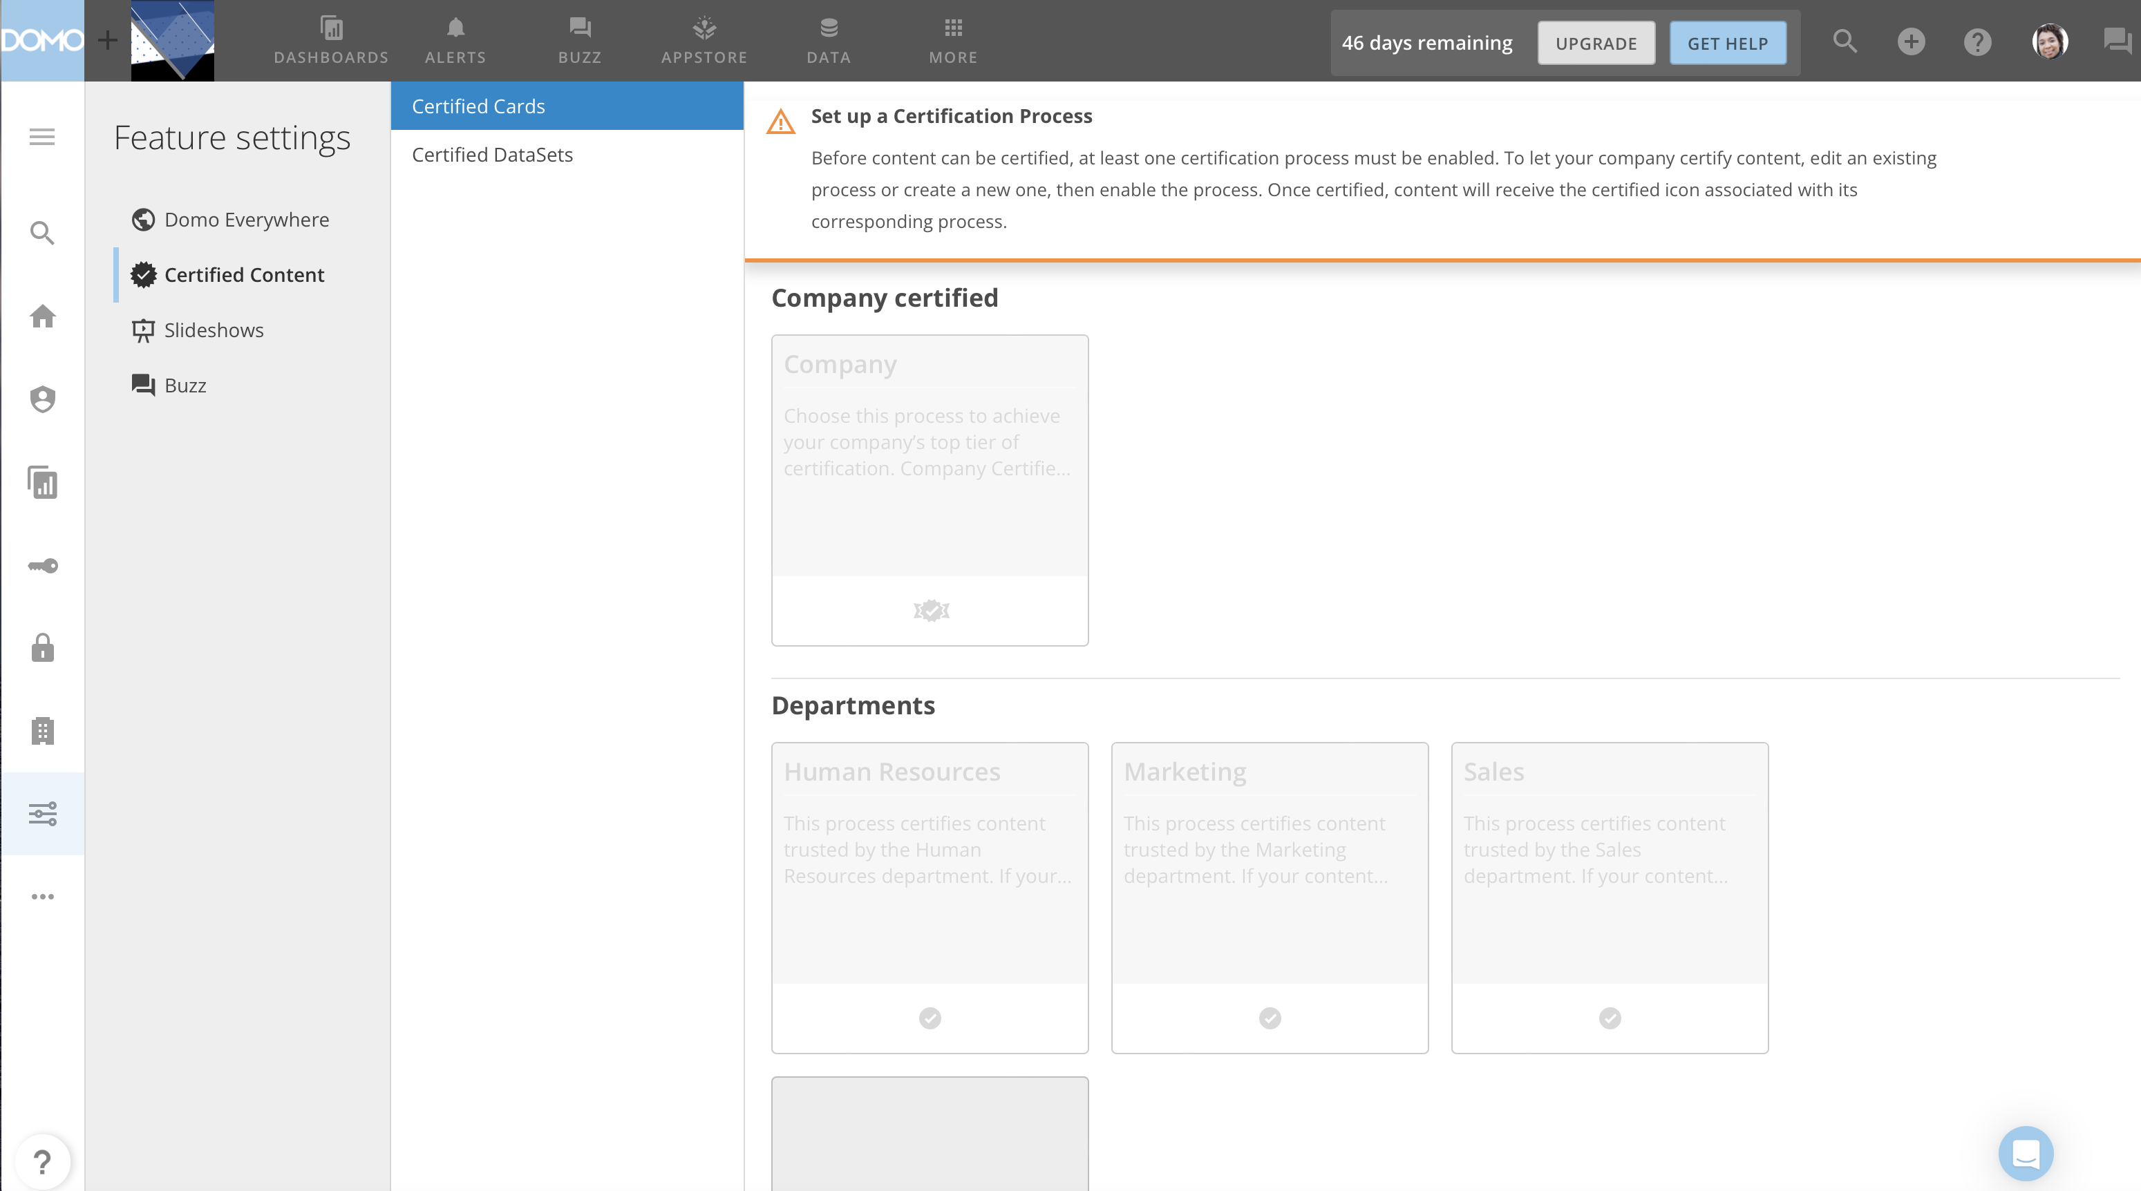

Slide 5
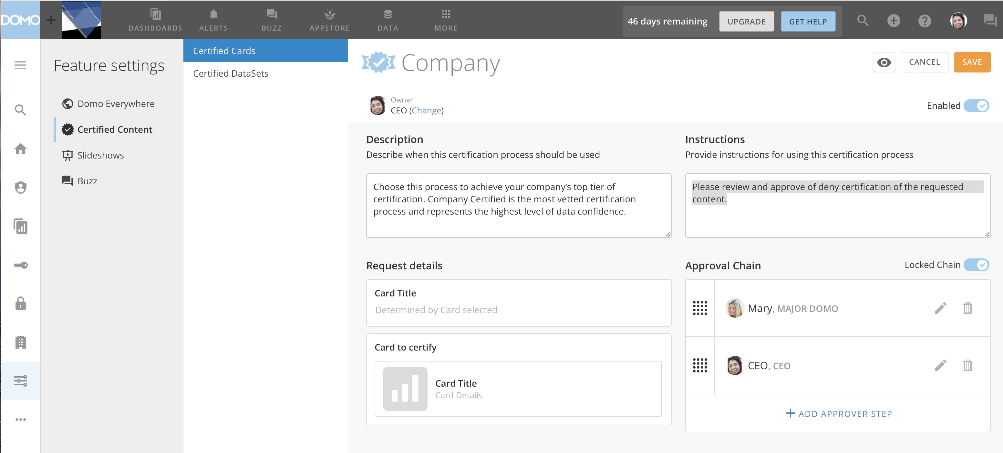

Slide 6
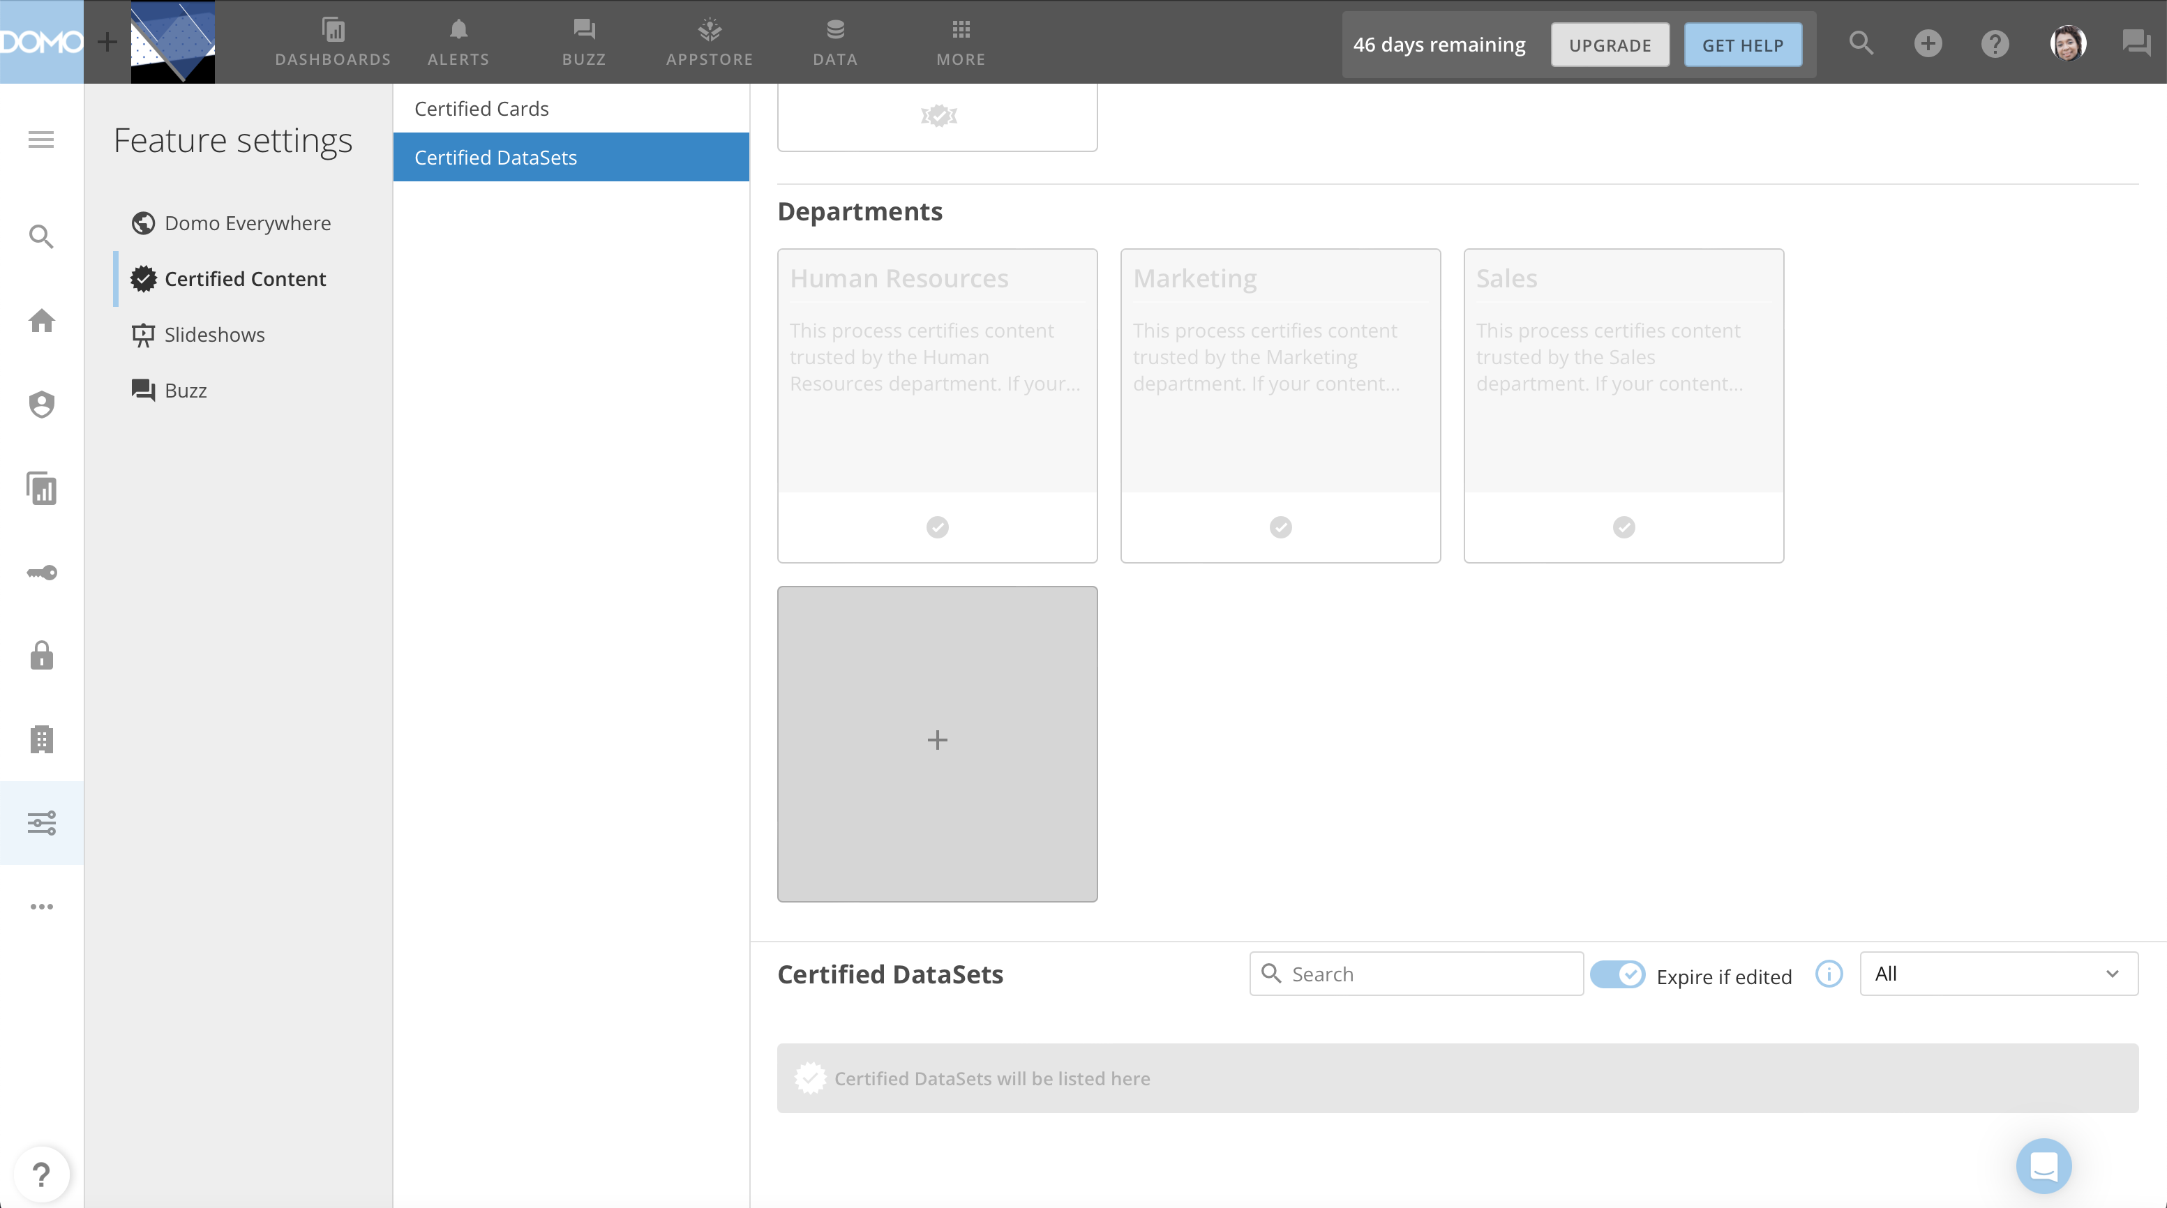

Slide 7
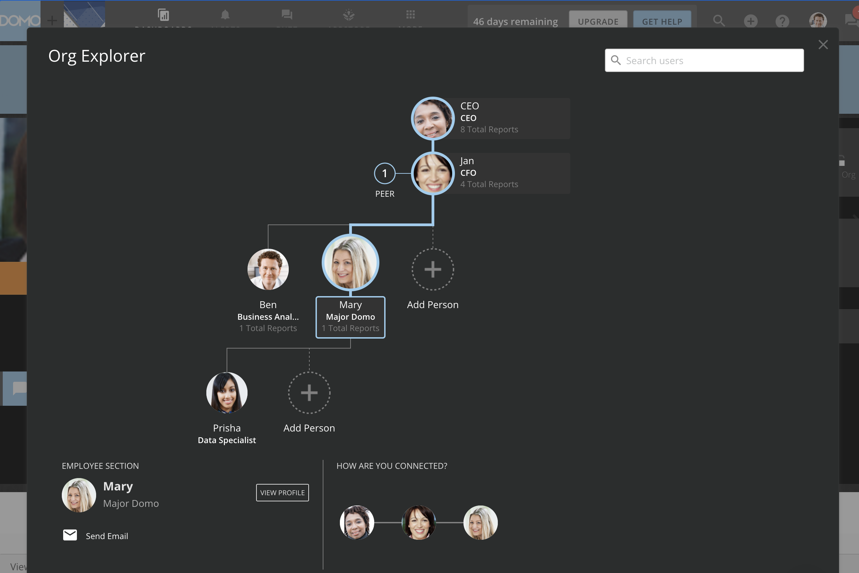

Slide 8
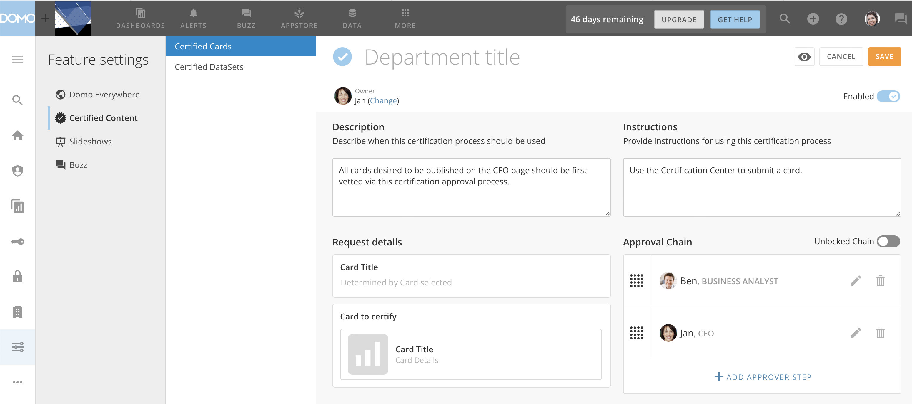

Slide 9
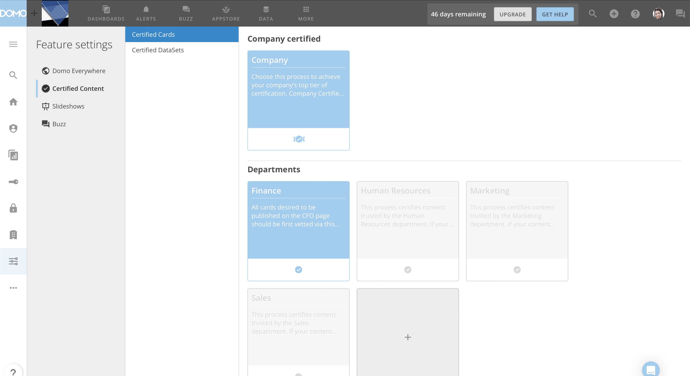

Slide 10
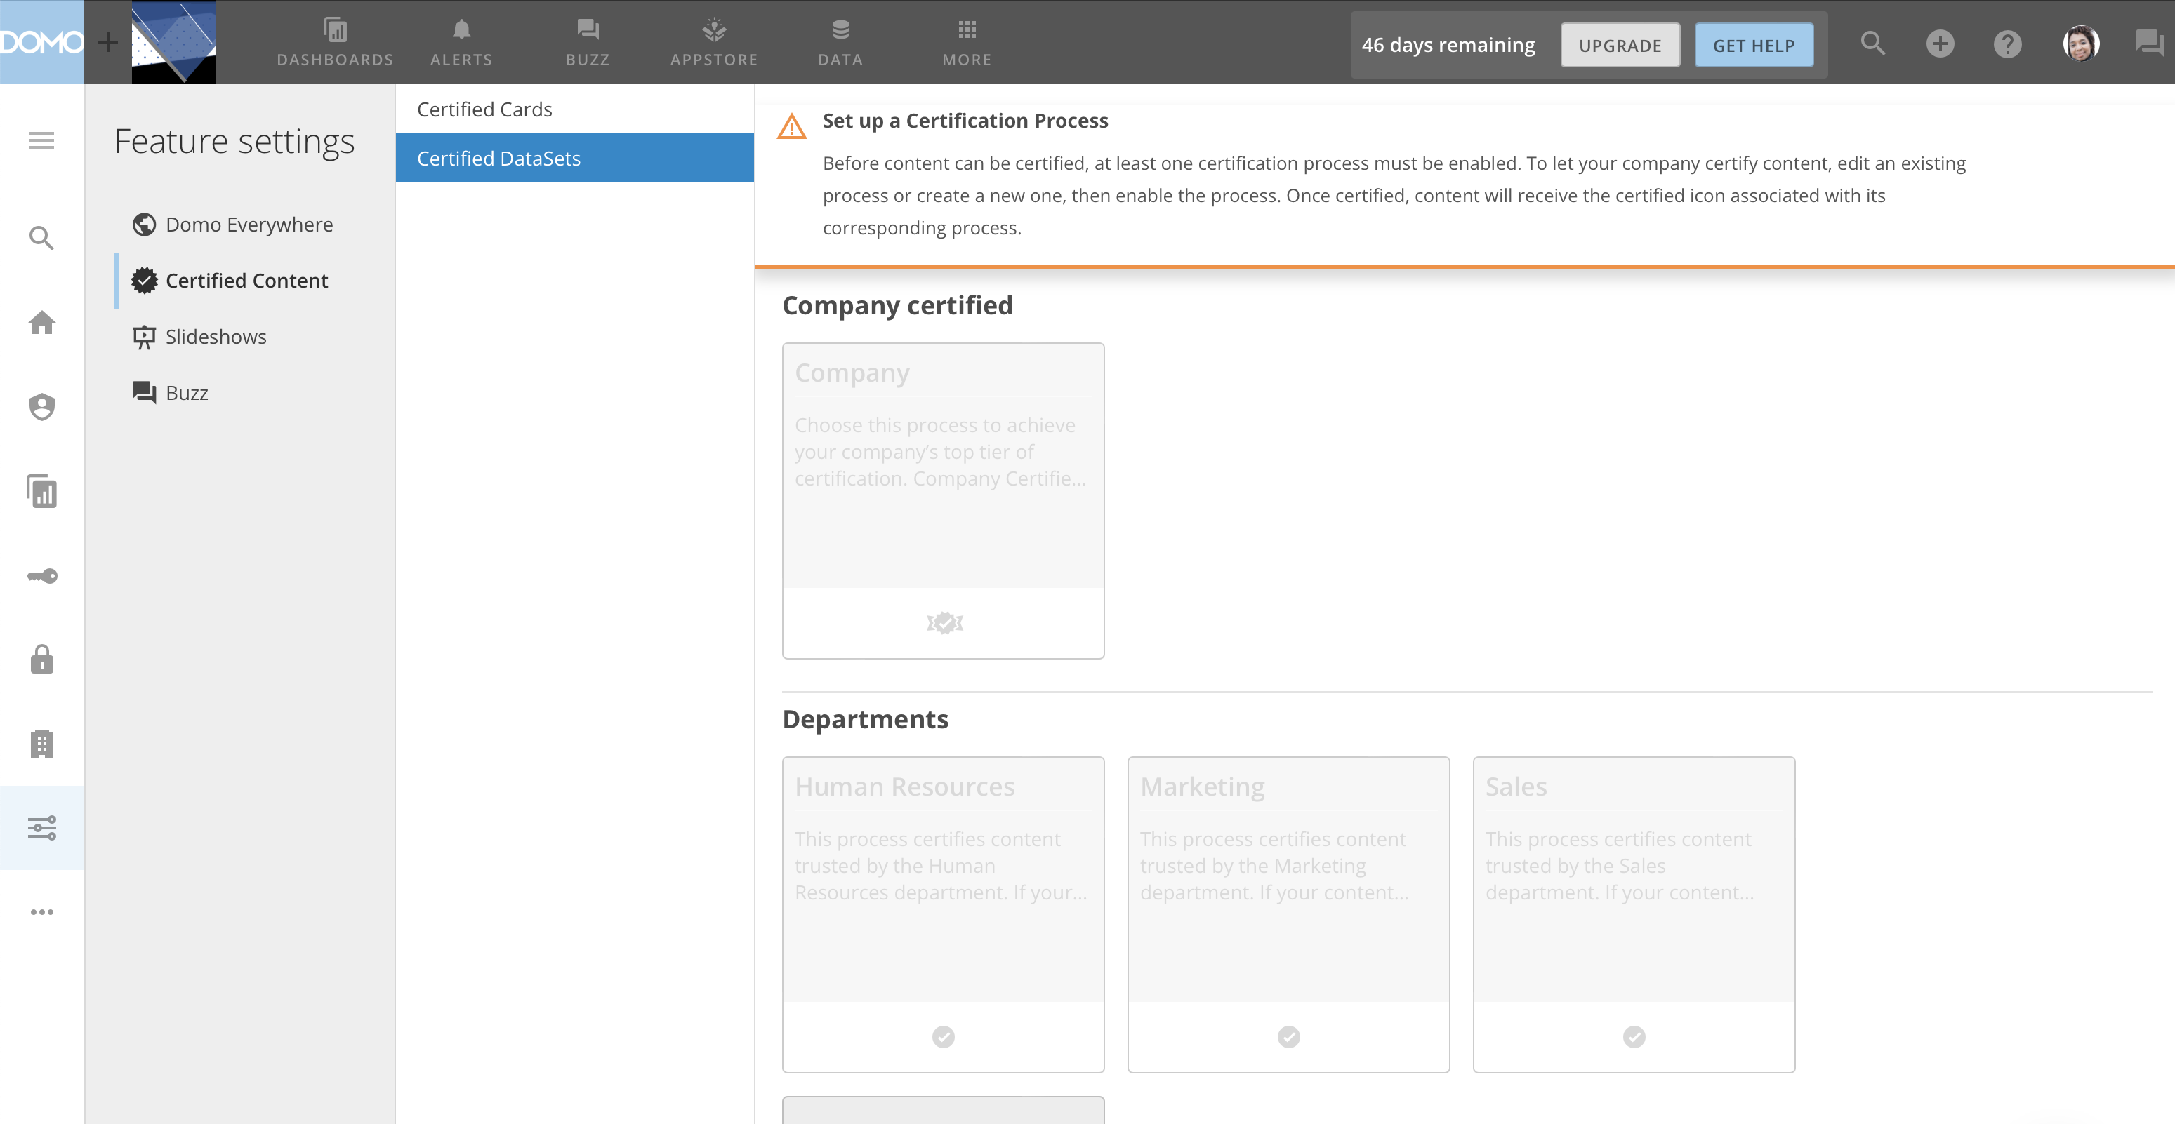

Slide 11
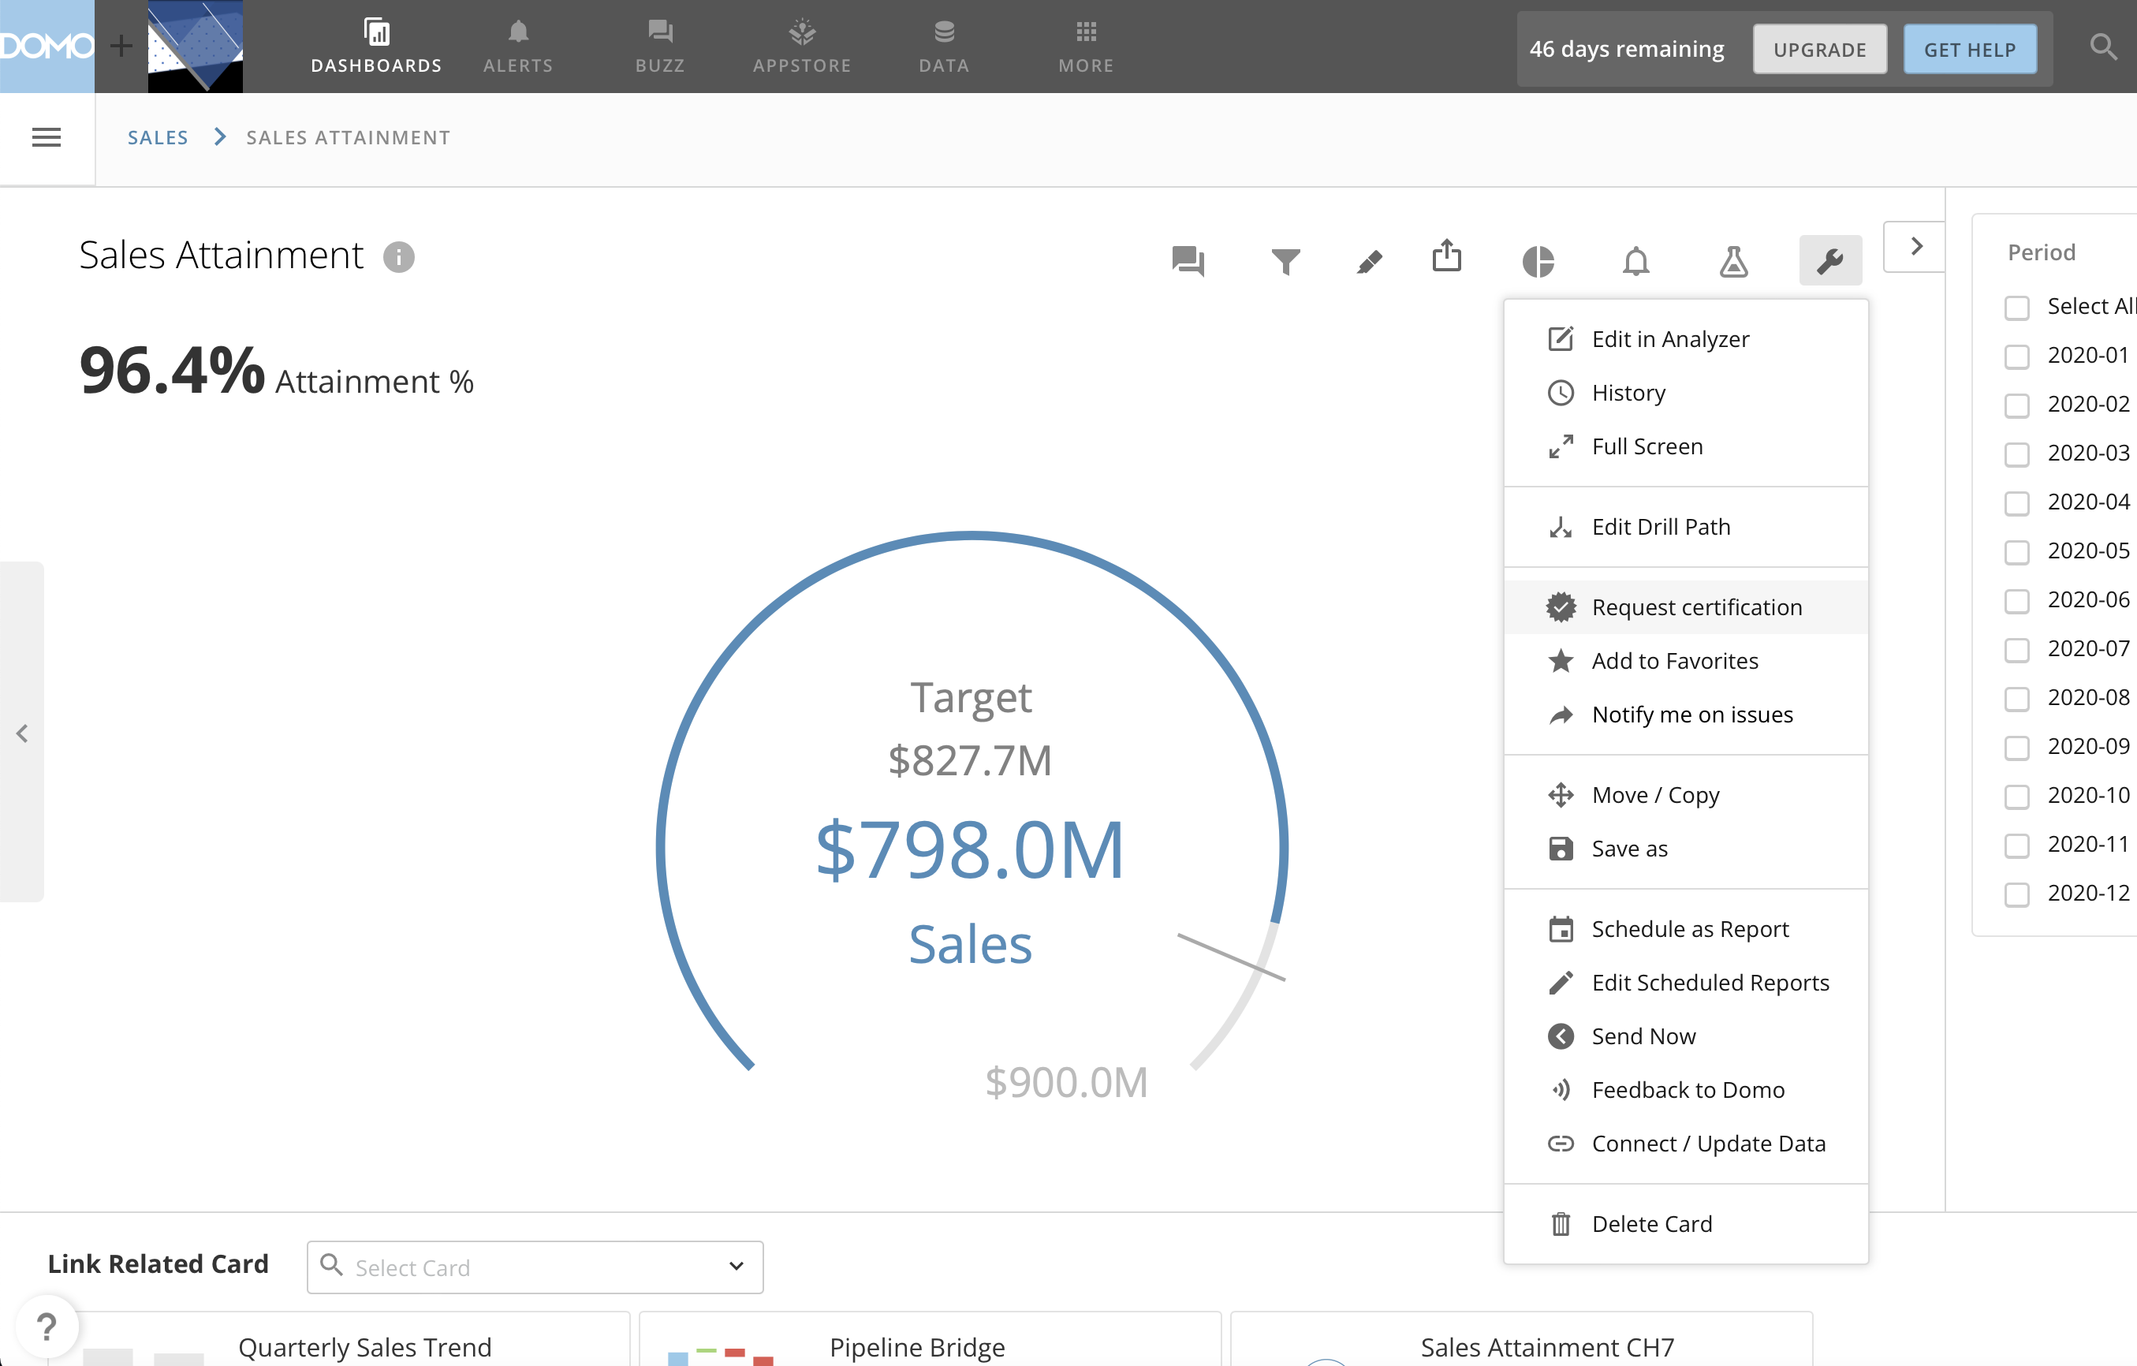

Slide 12
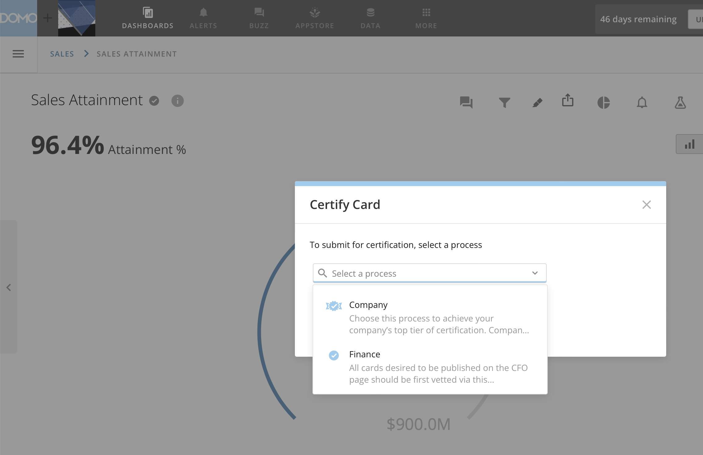

Slide 13
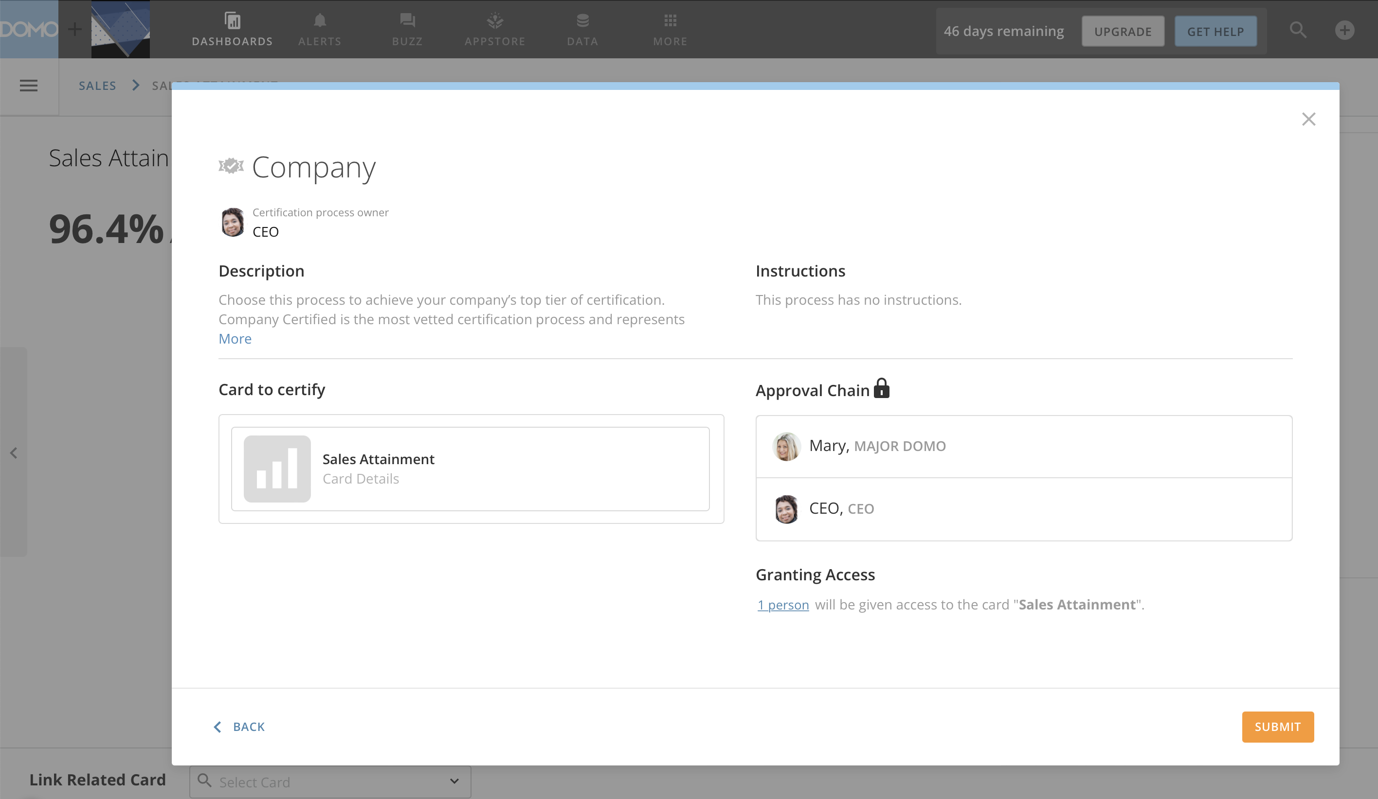

Slide 14
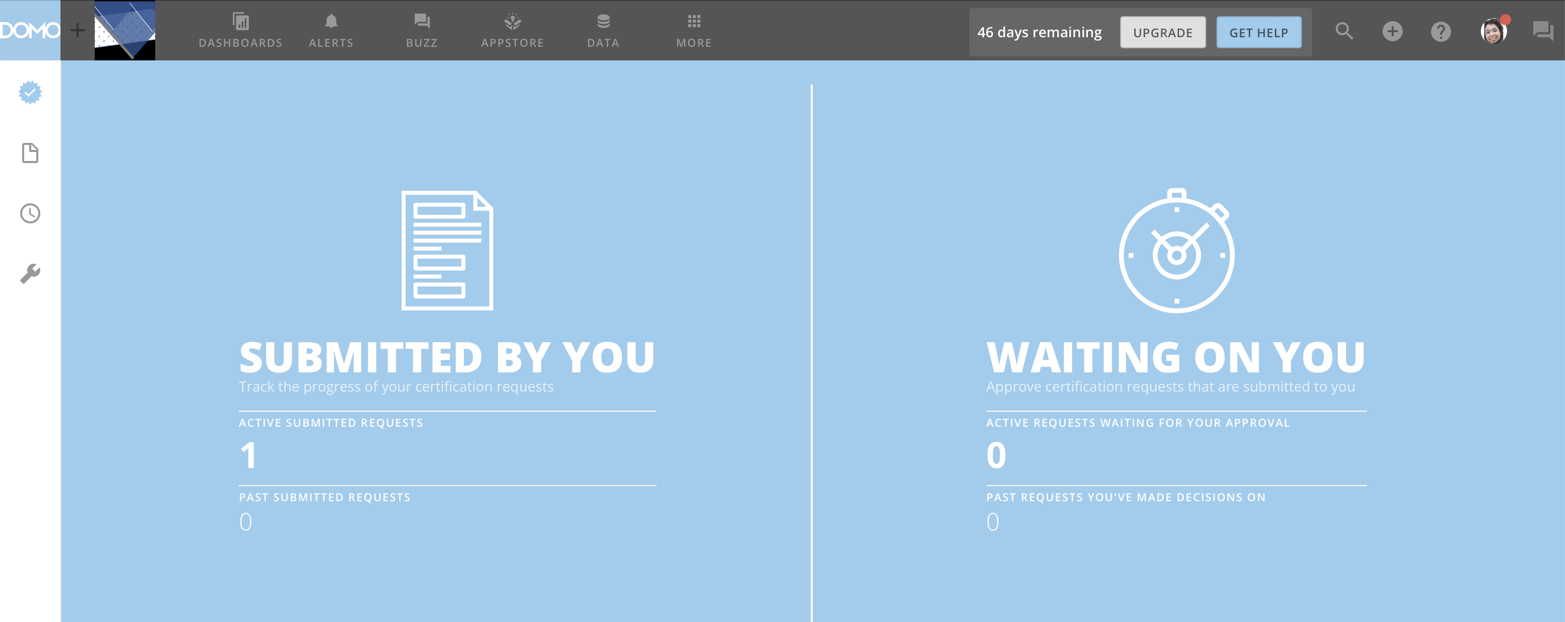

Slide 15
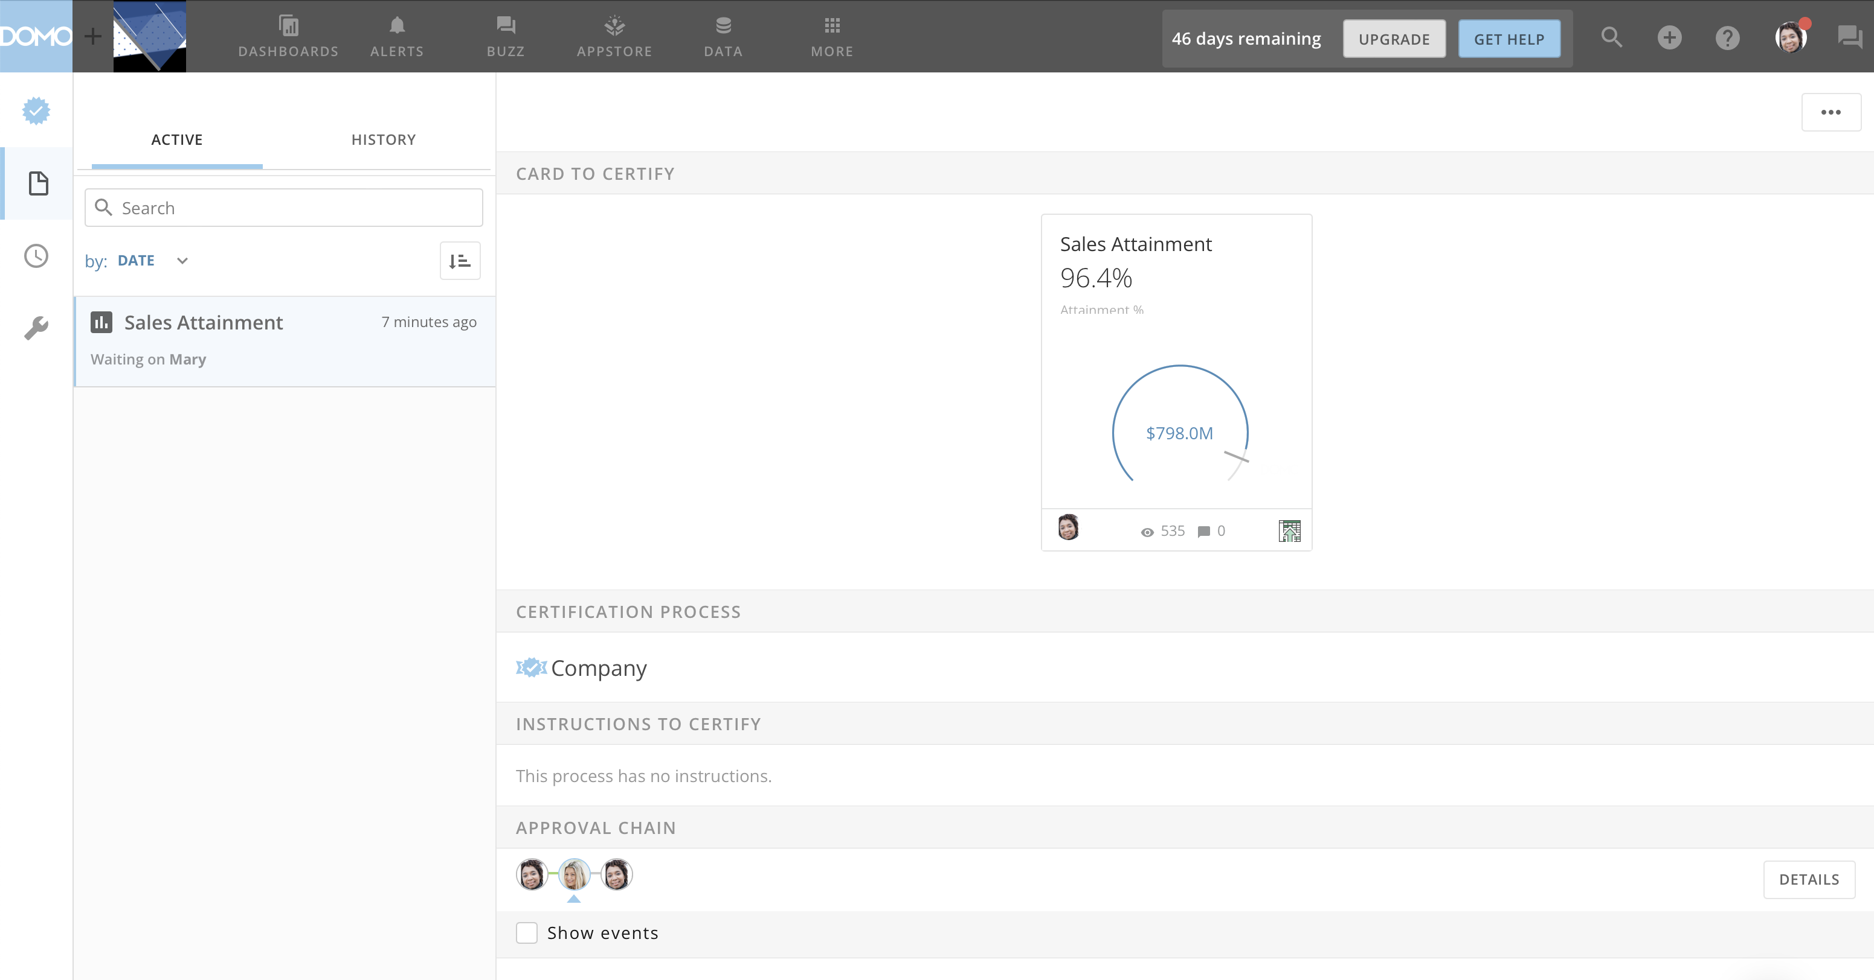

Slide 16
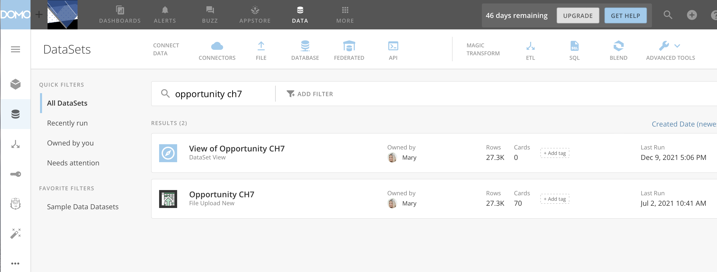

Slide 17
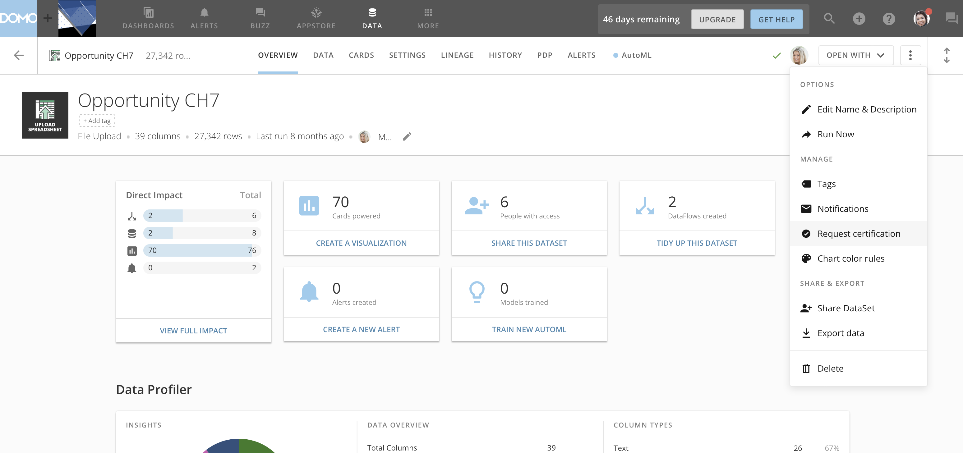

Slide 18
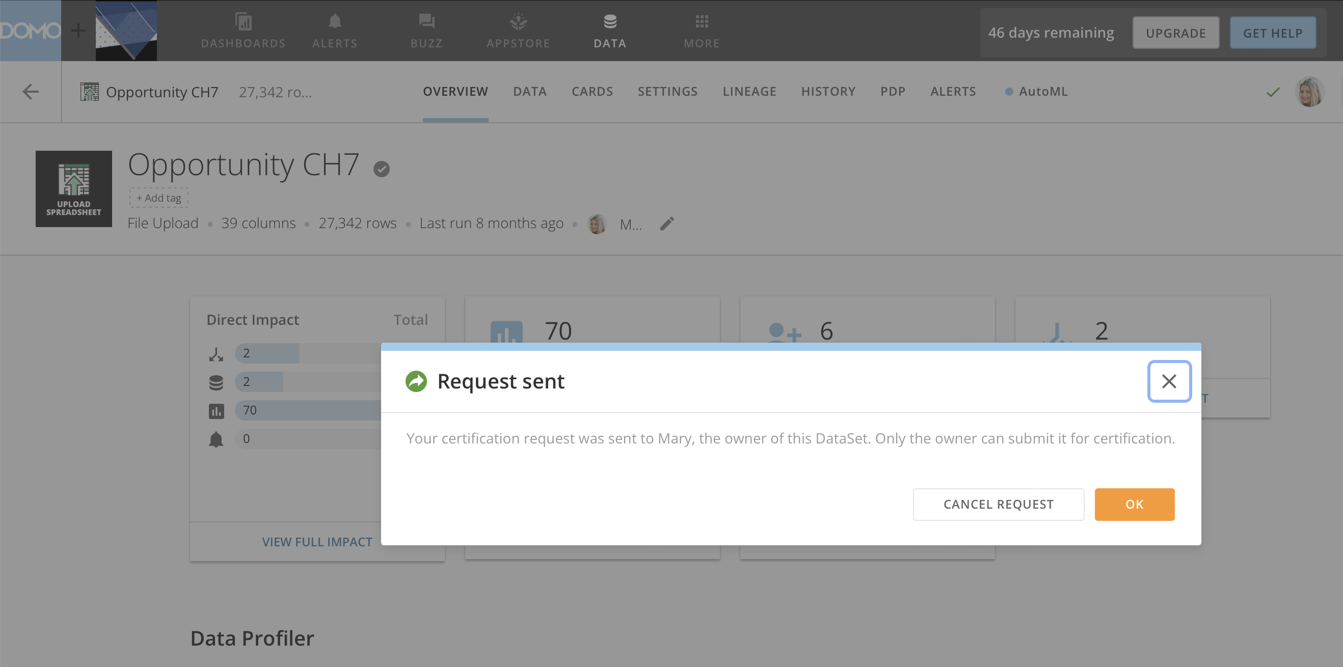

Slide 19
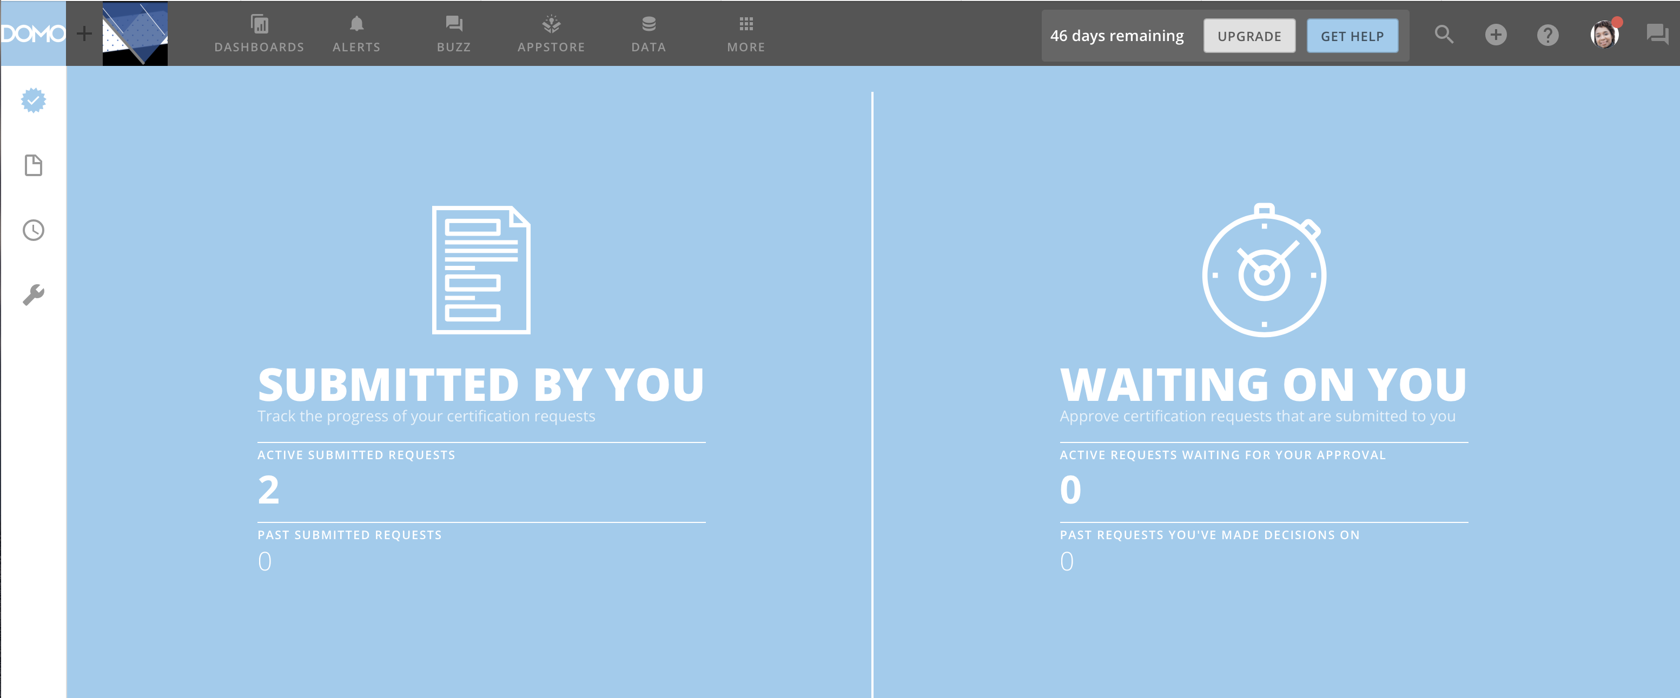

Slide 20

Issues
Queue
Domo Buzz
@request
Domo Support Queue
Backlog & Sprints Queue

Slide 21
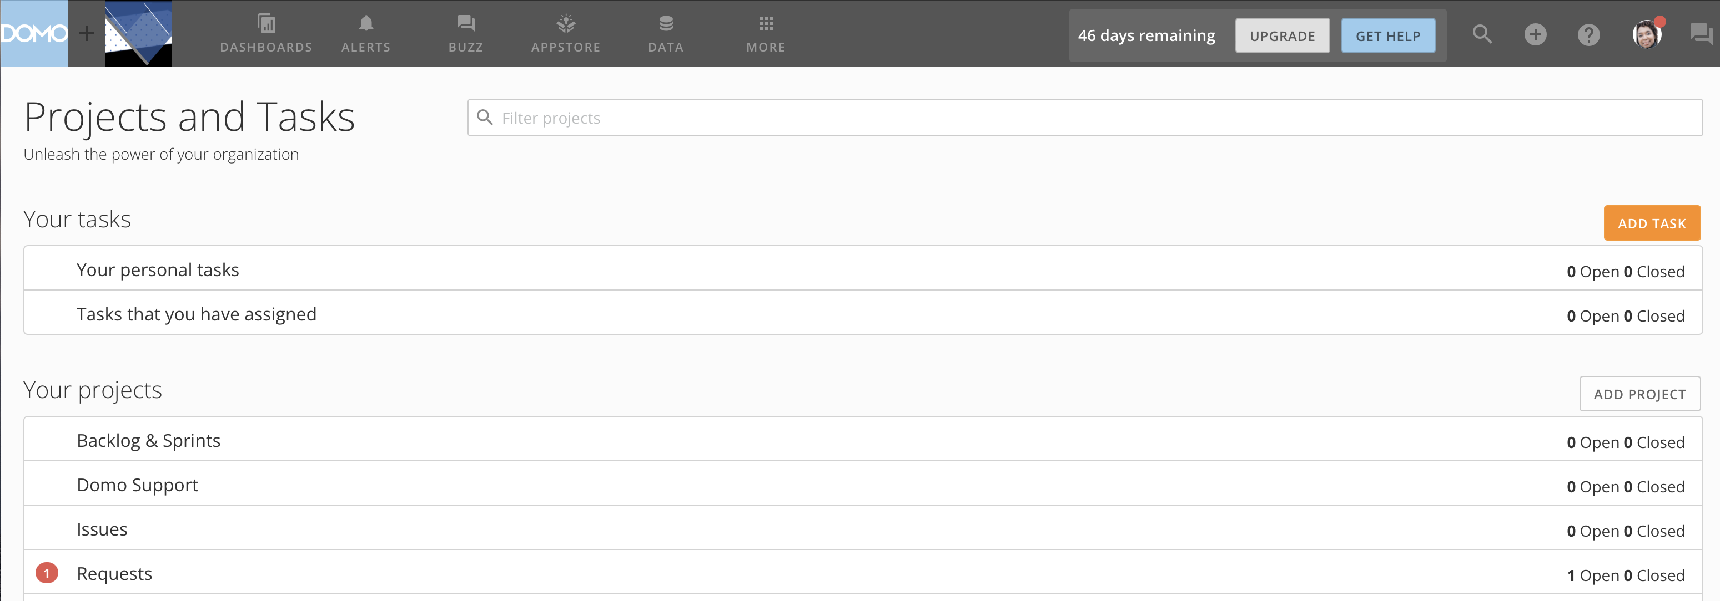
Add Projects Here
Names of Added Projects

Slide 22
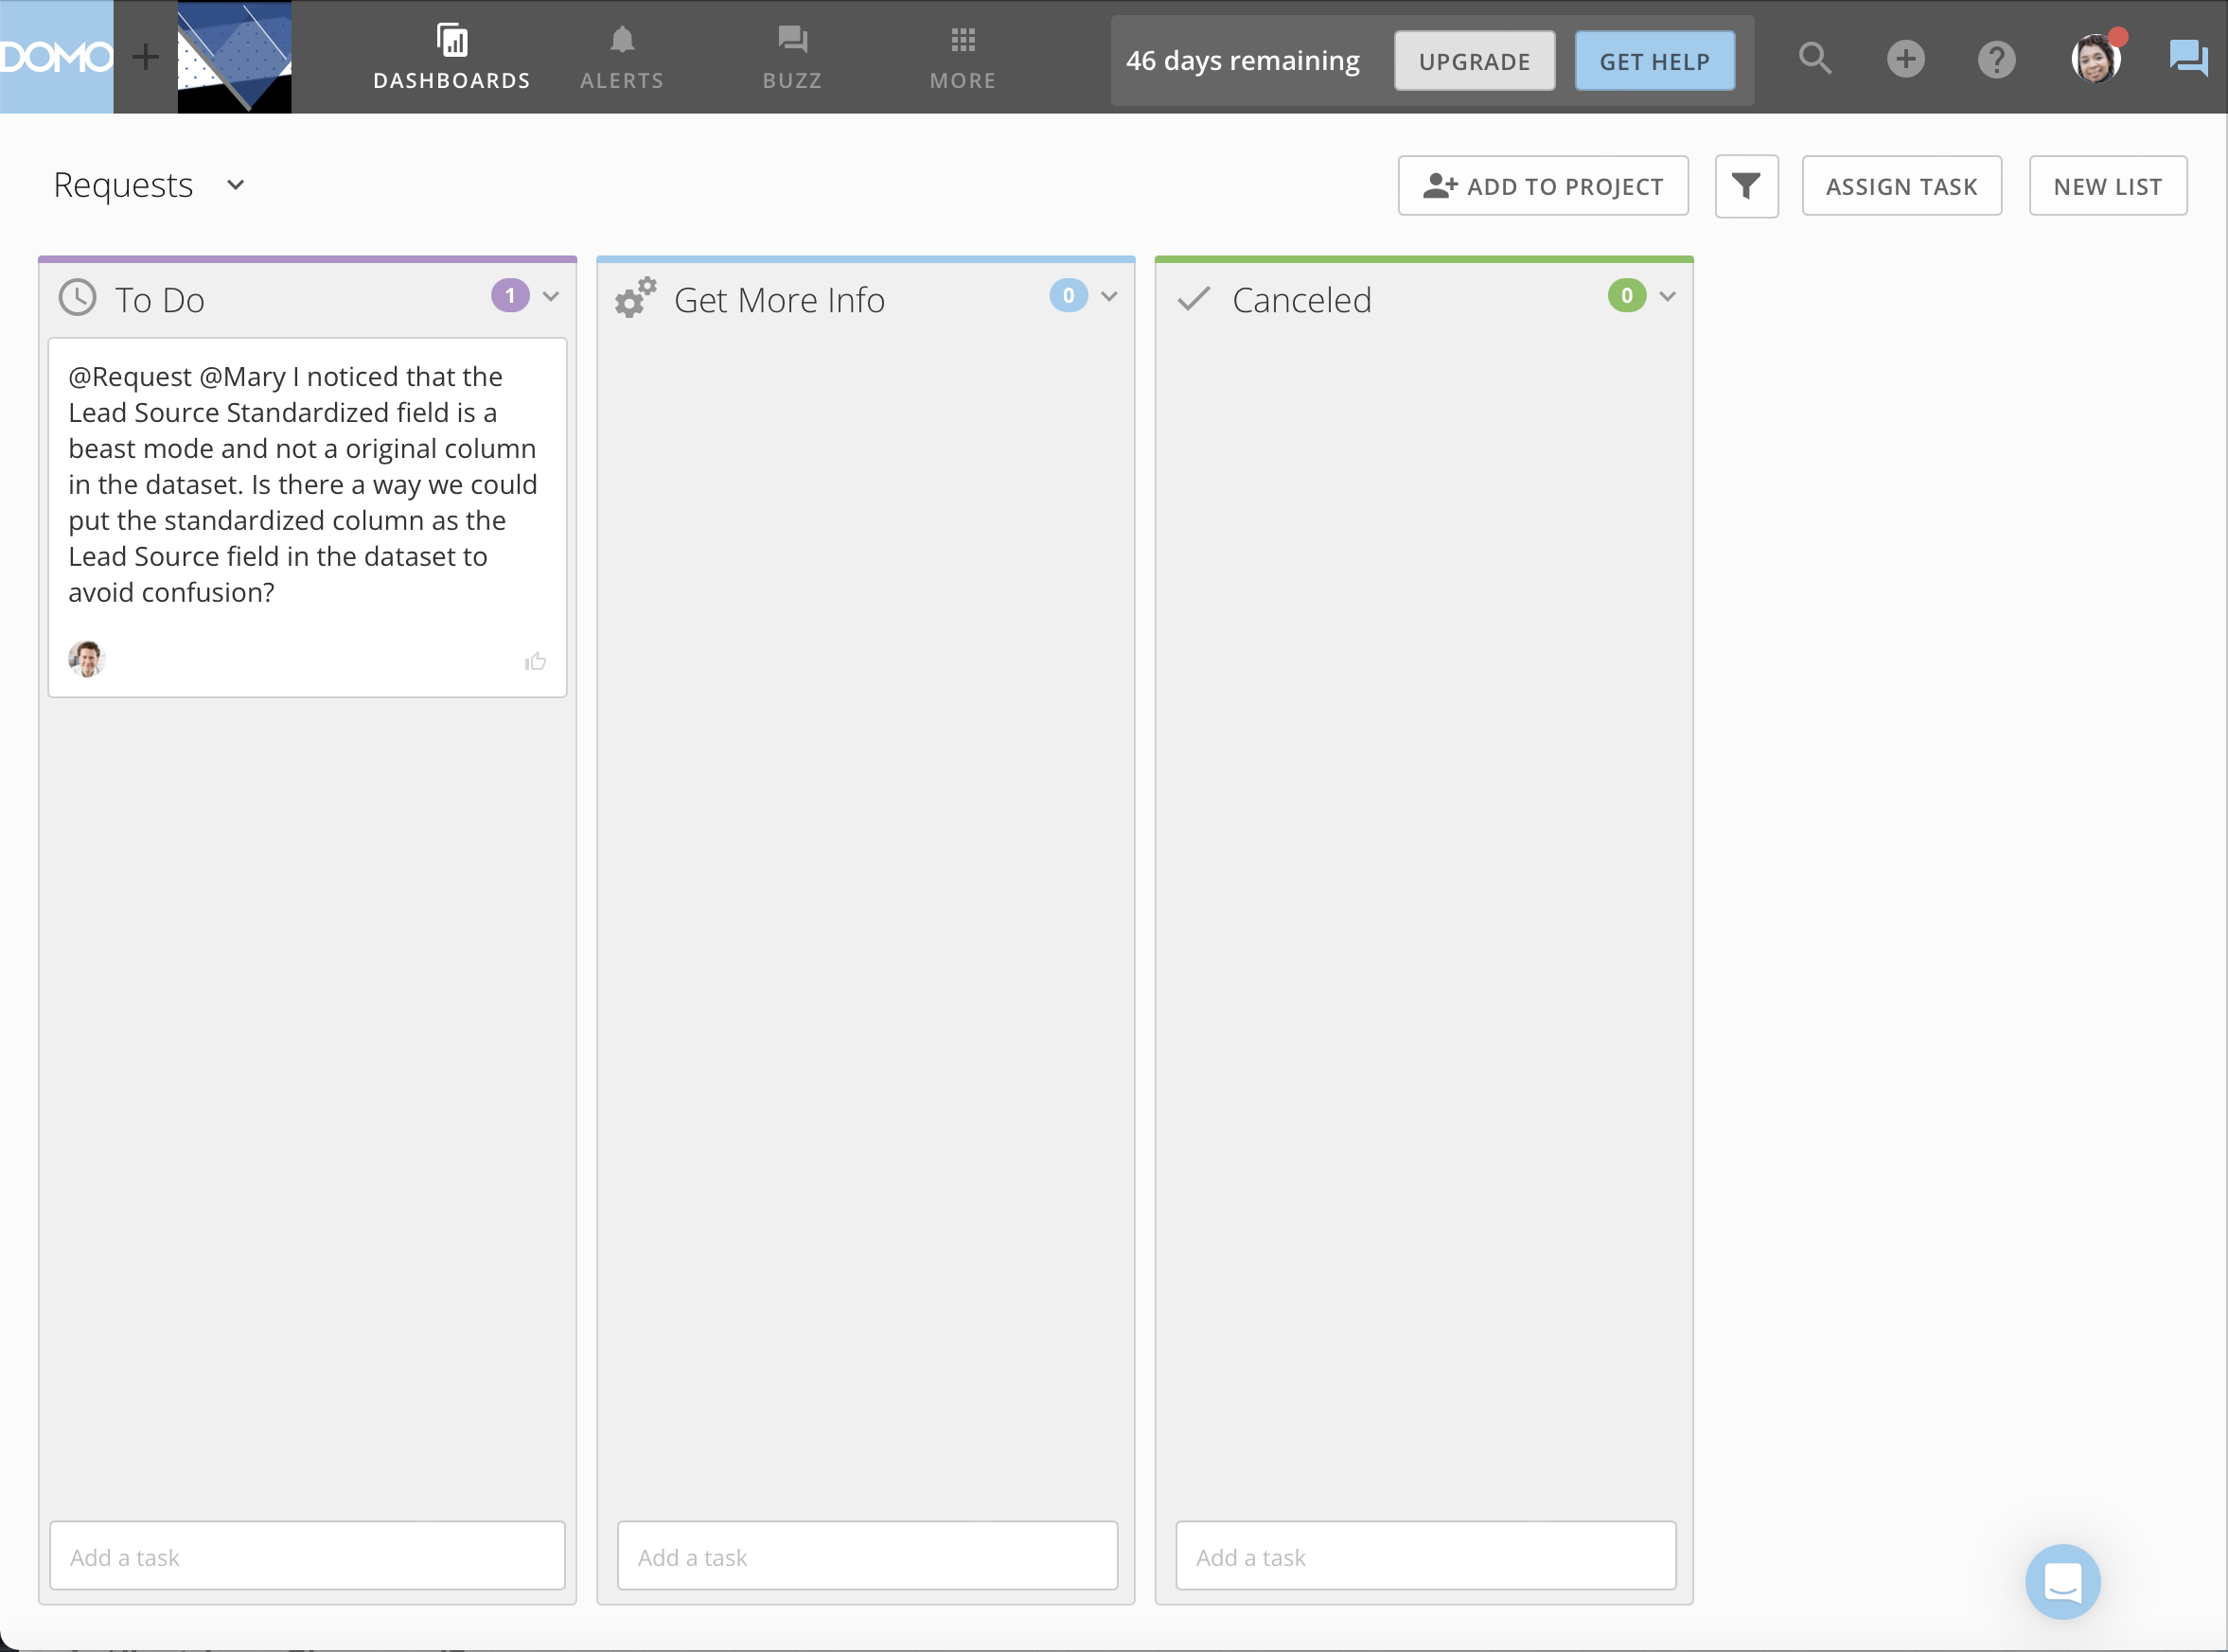

Slide 23
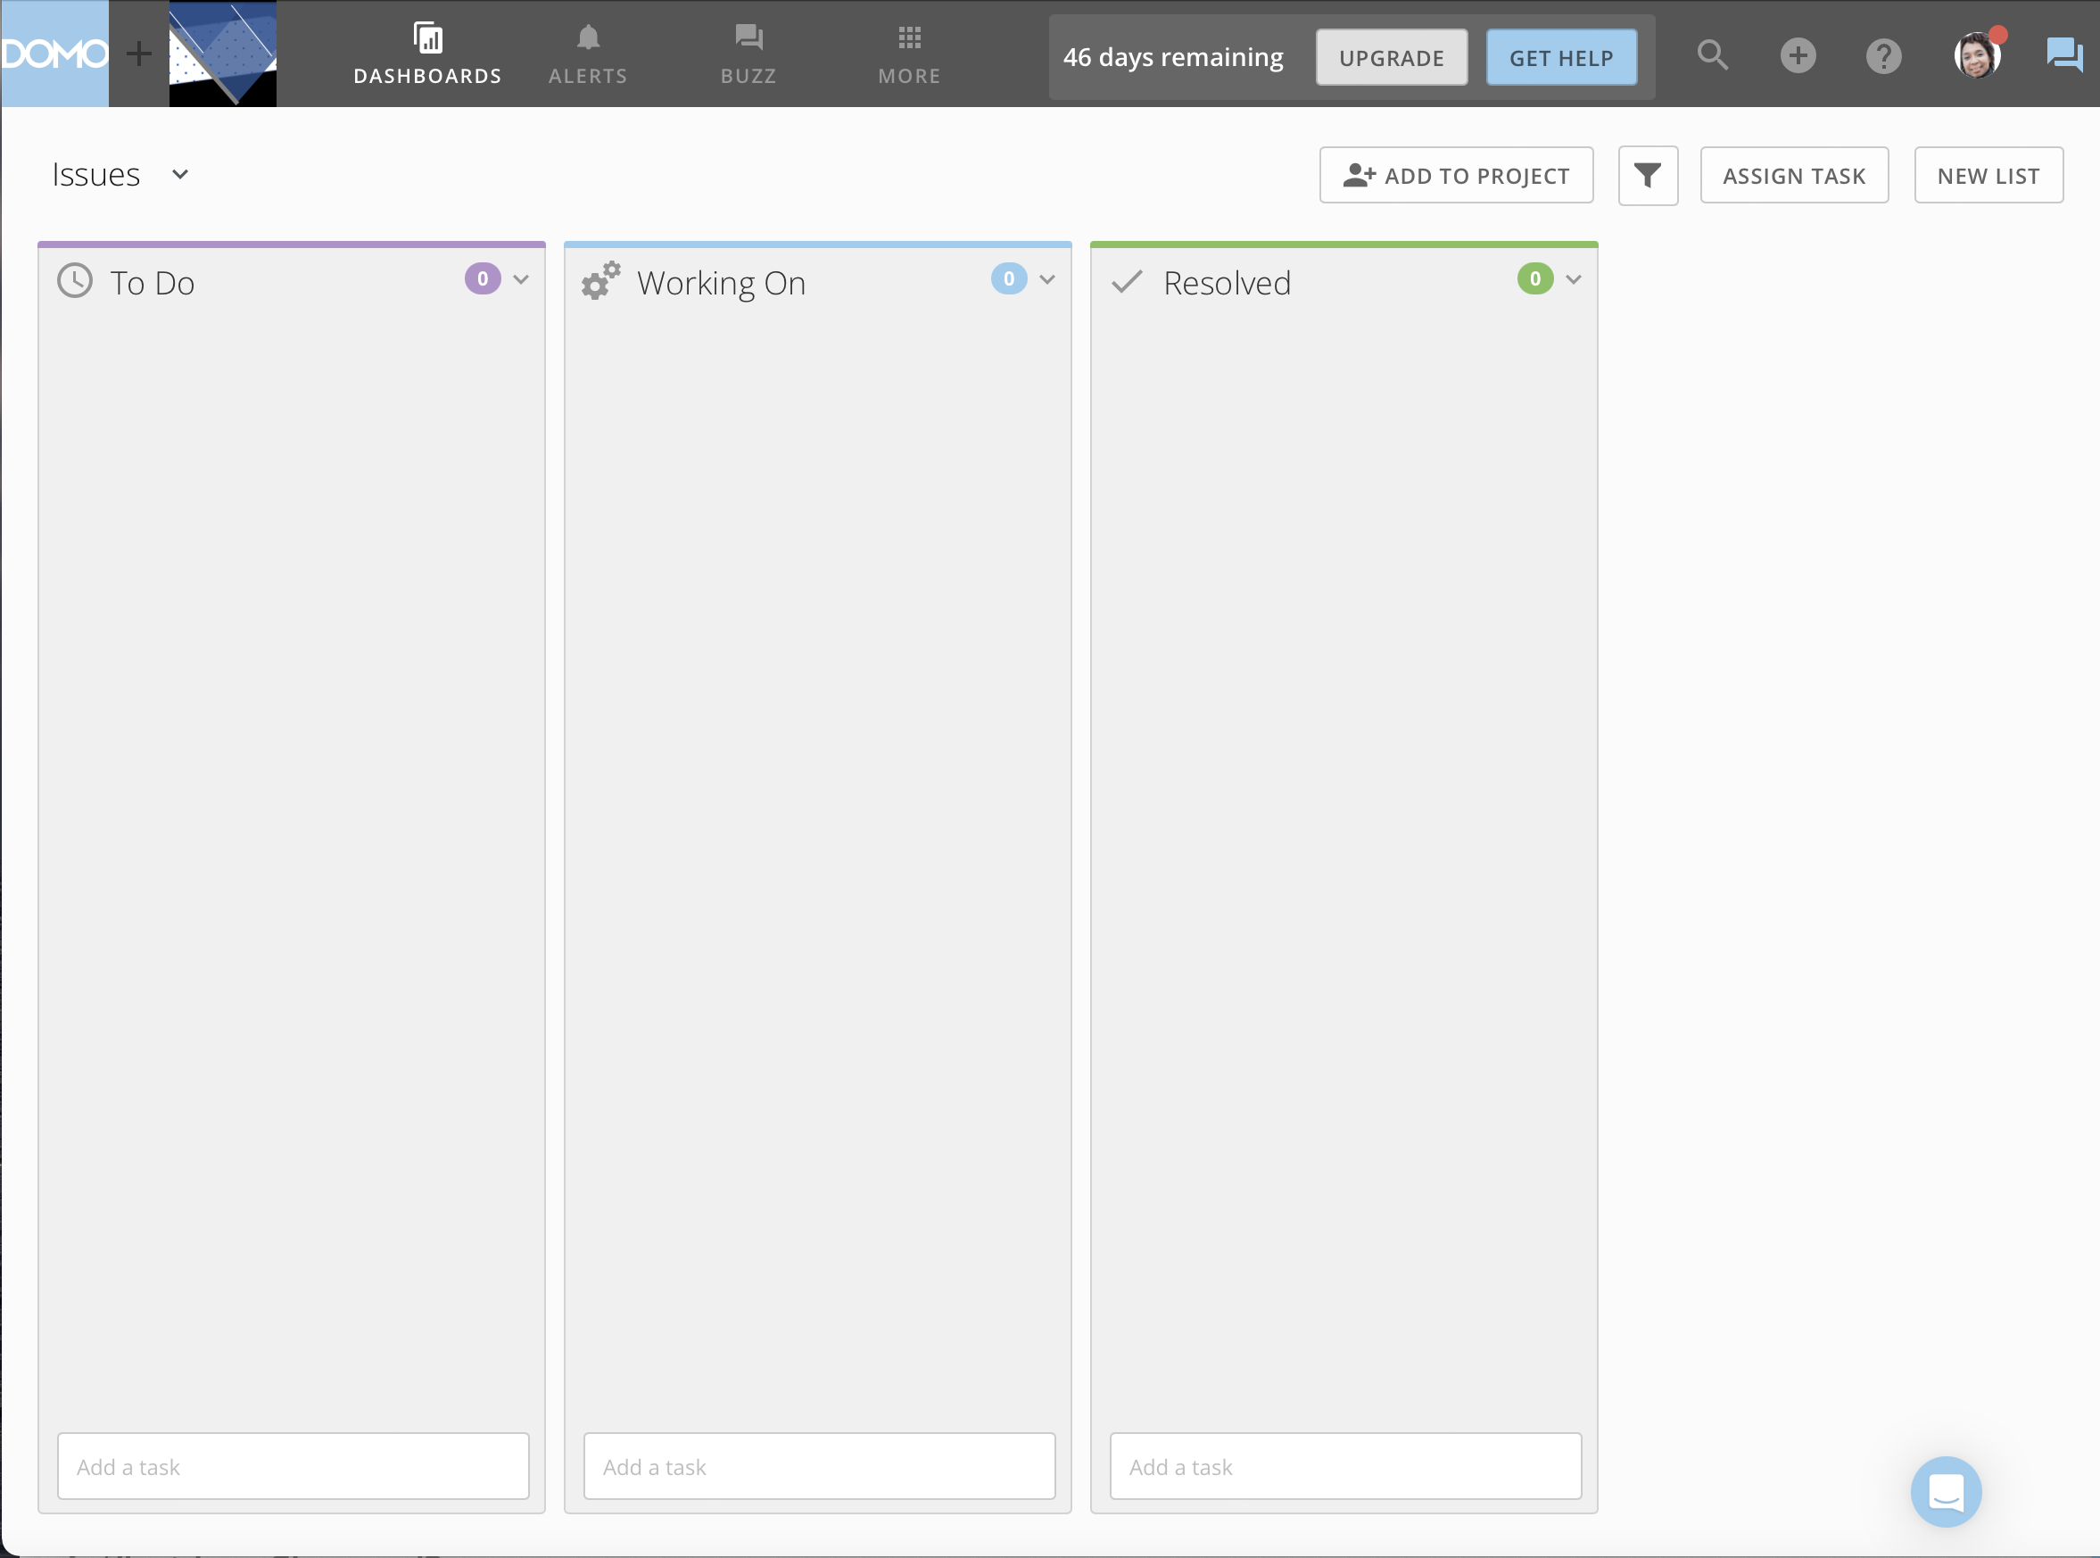

Slide 24
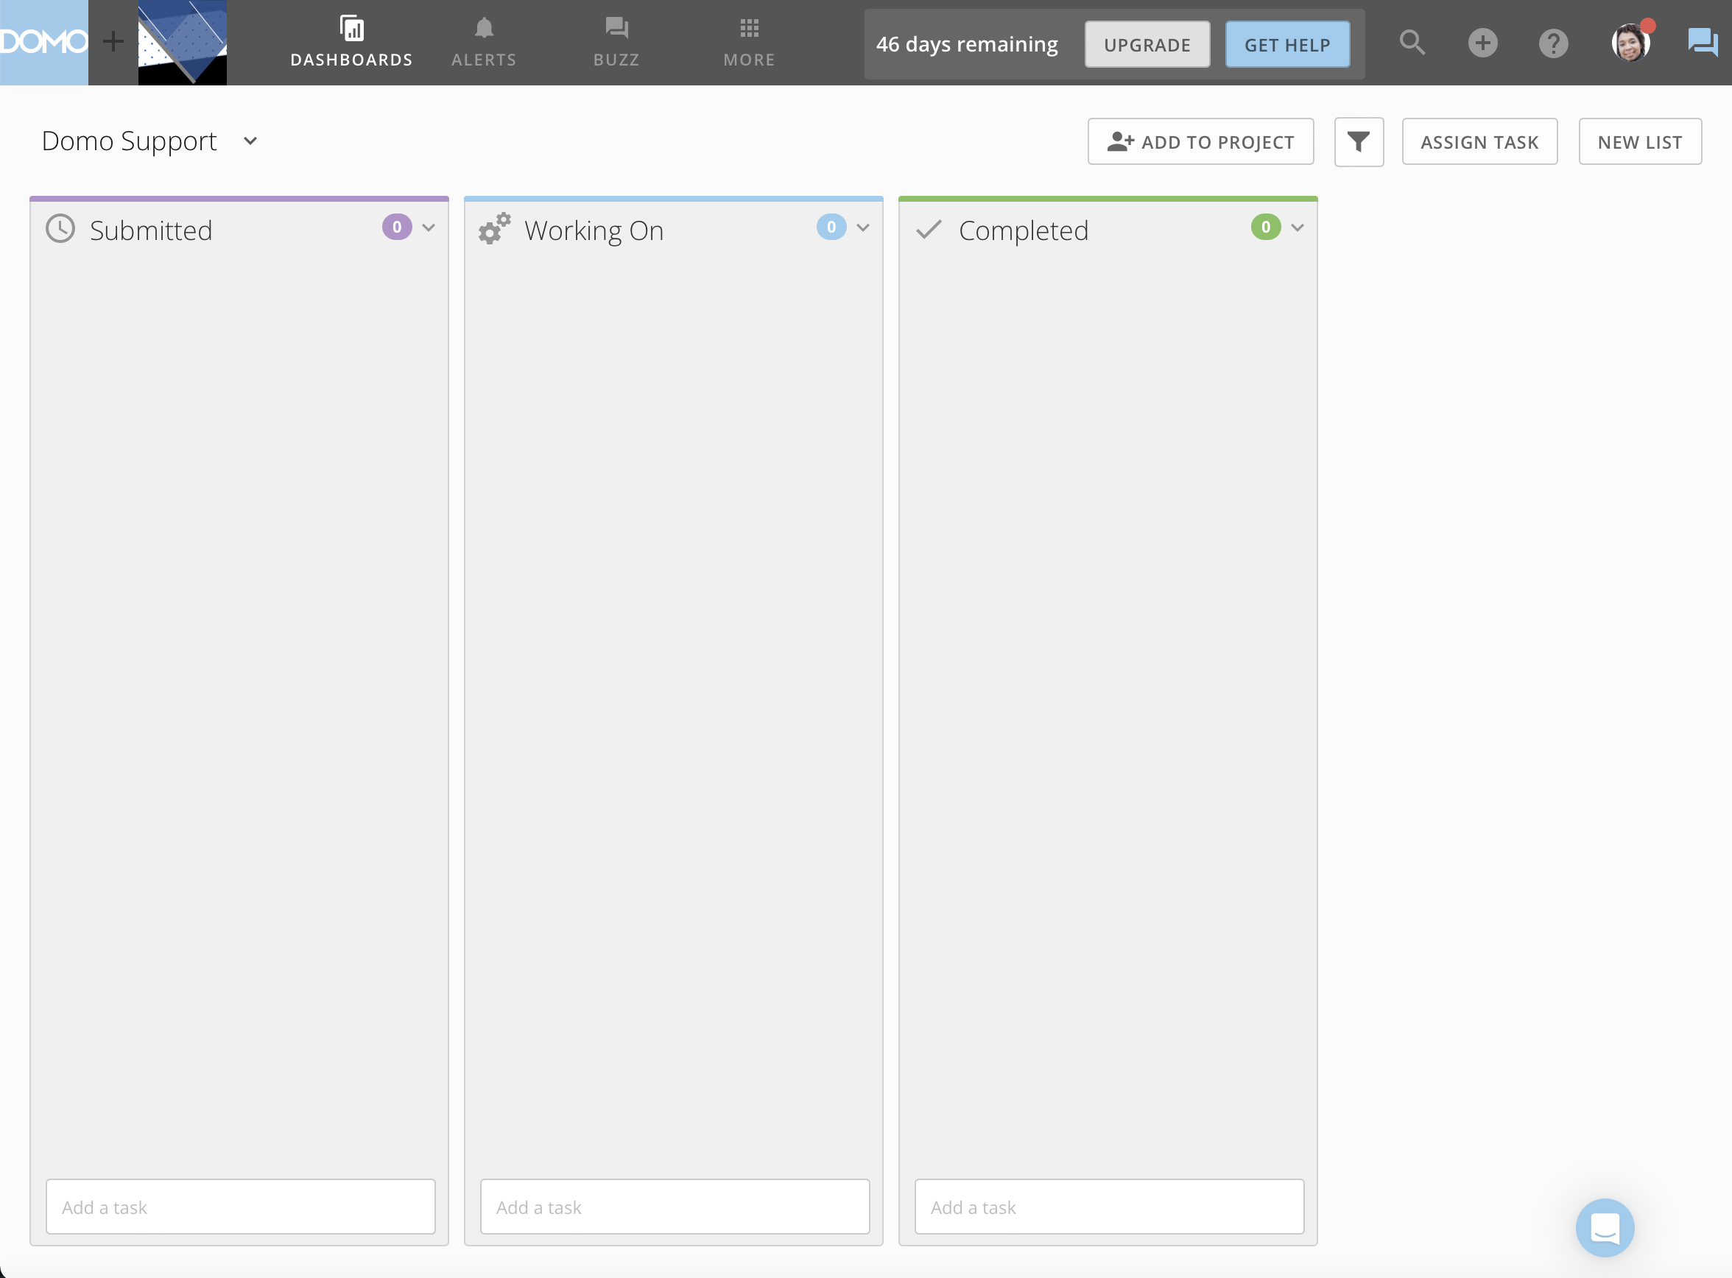

Slide 25
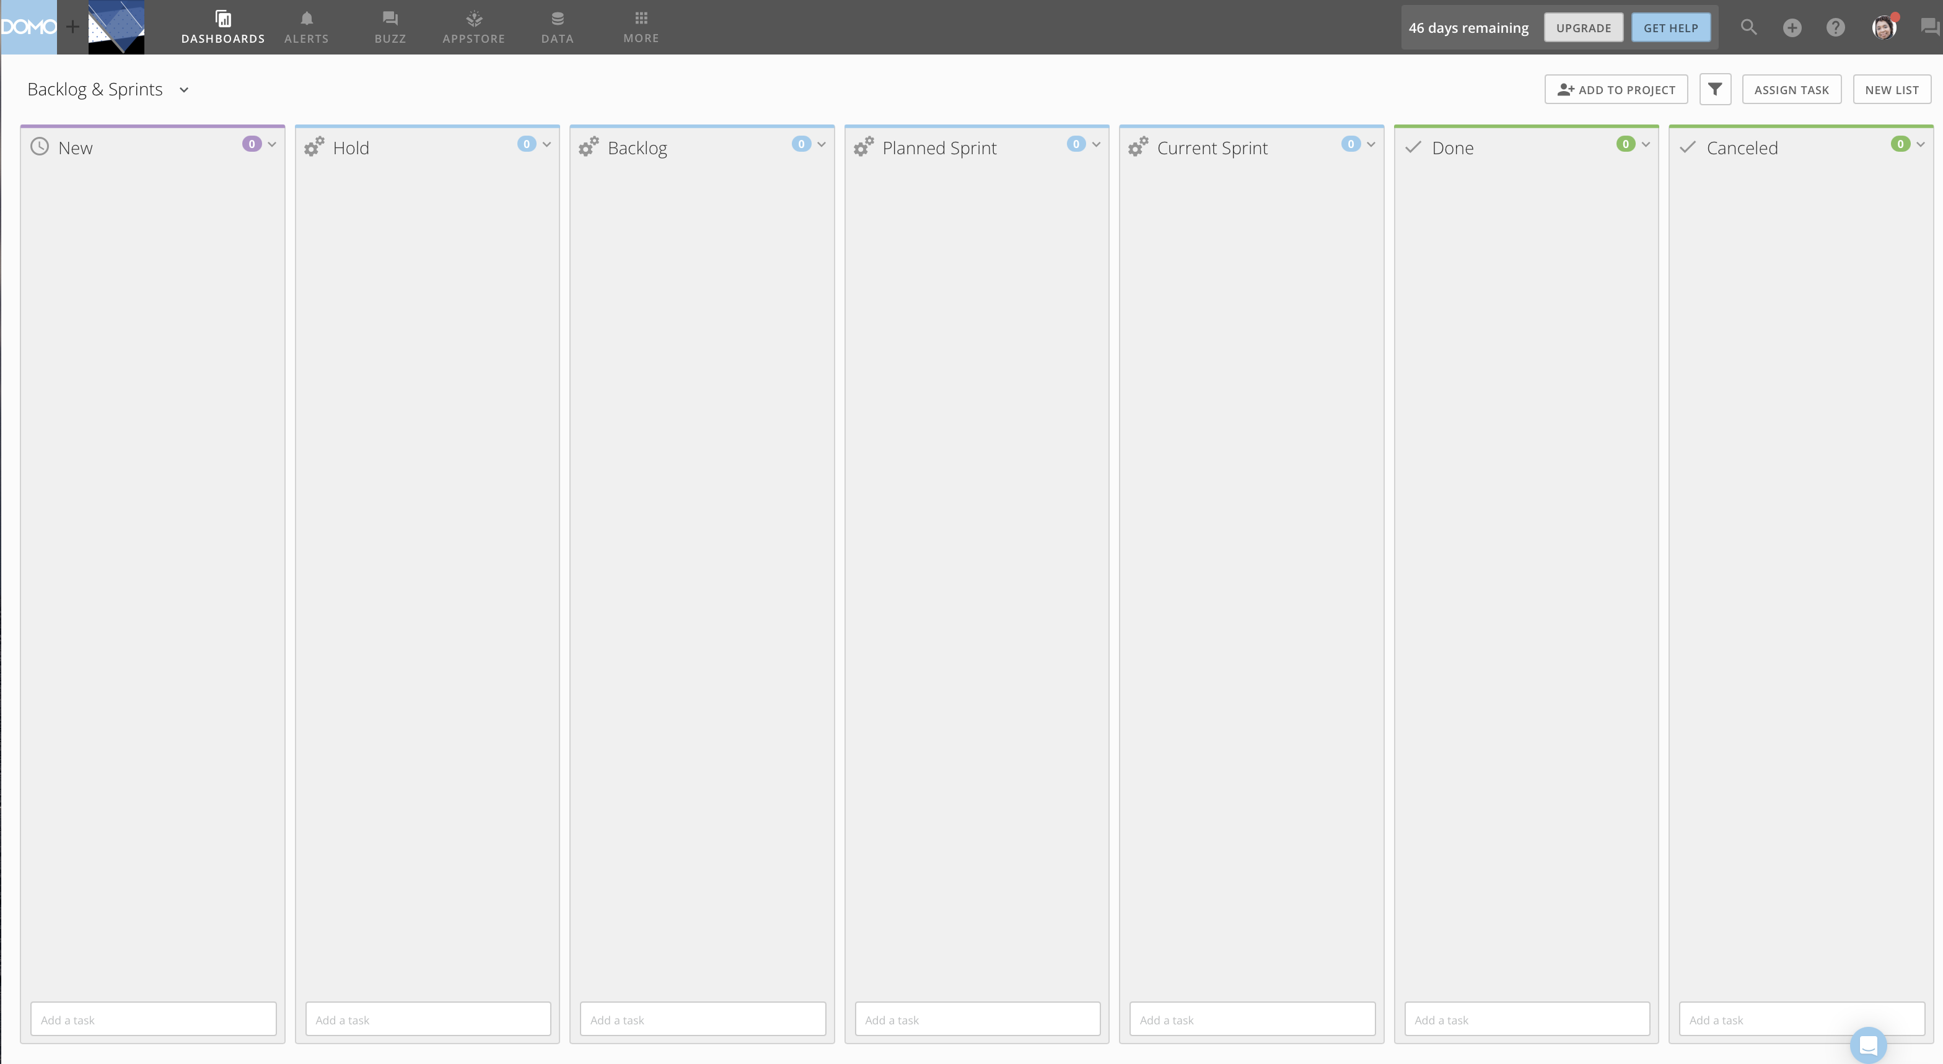

Slide 26
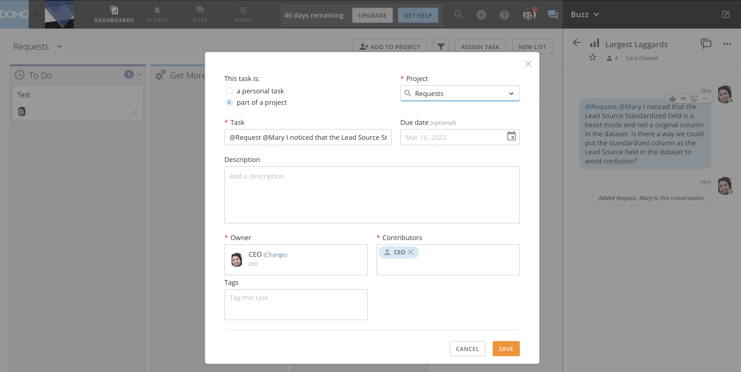

Slide 27
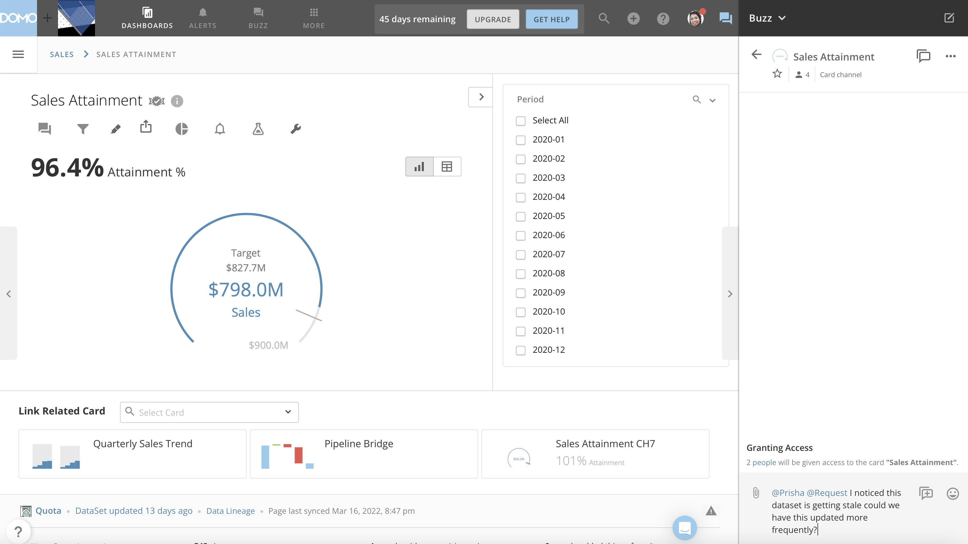

Slide 28
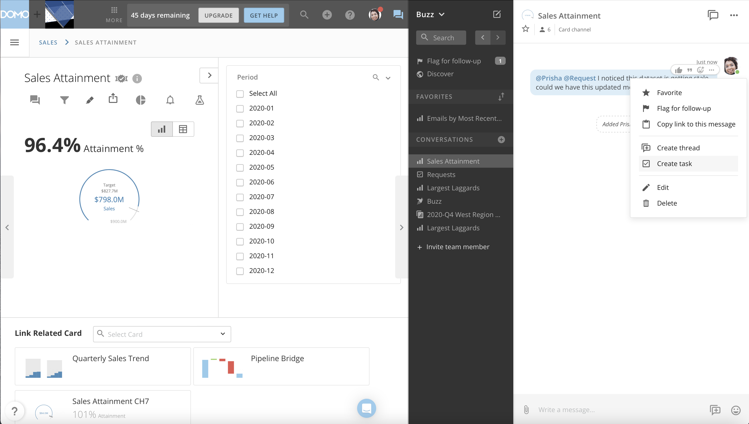

Slide 29
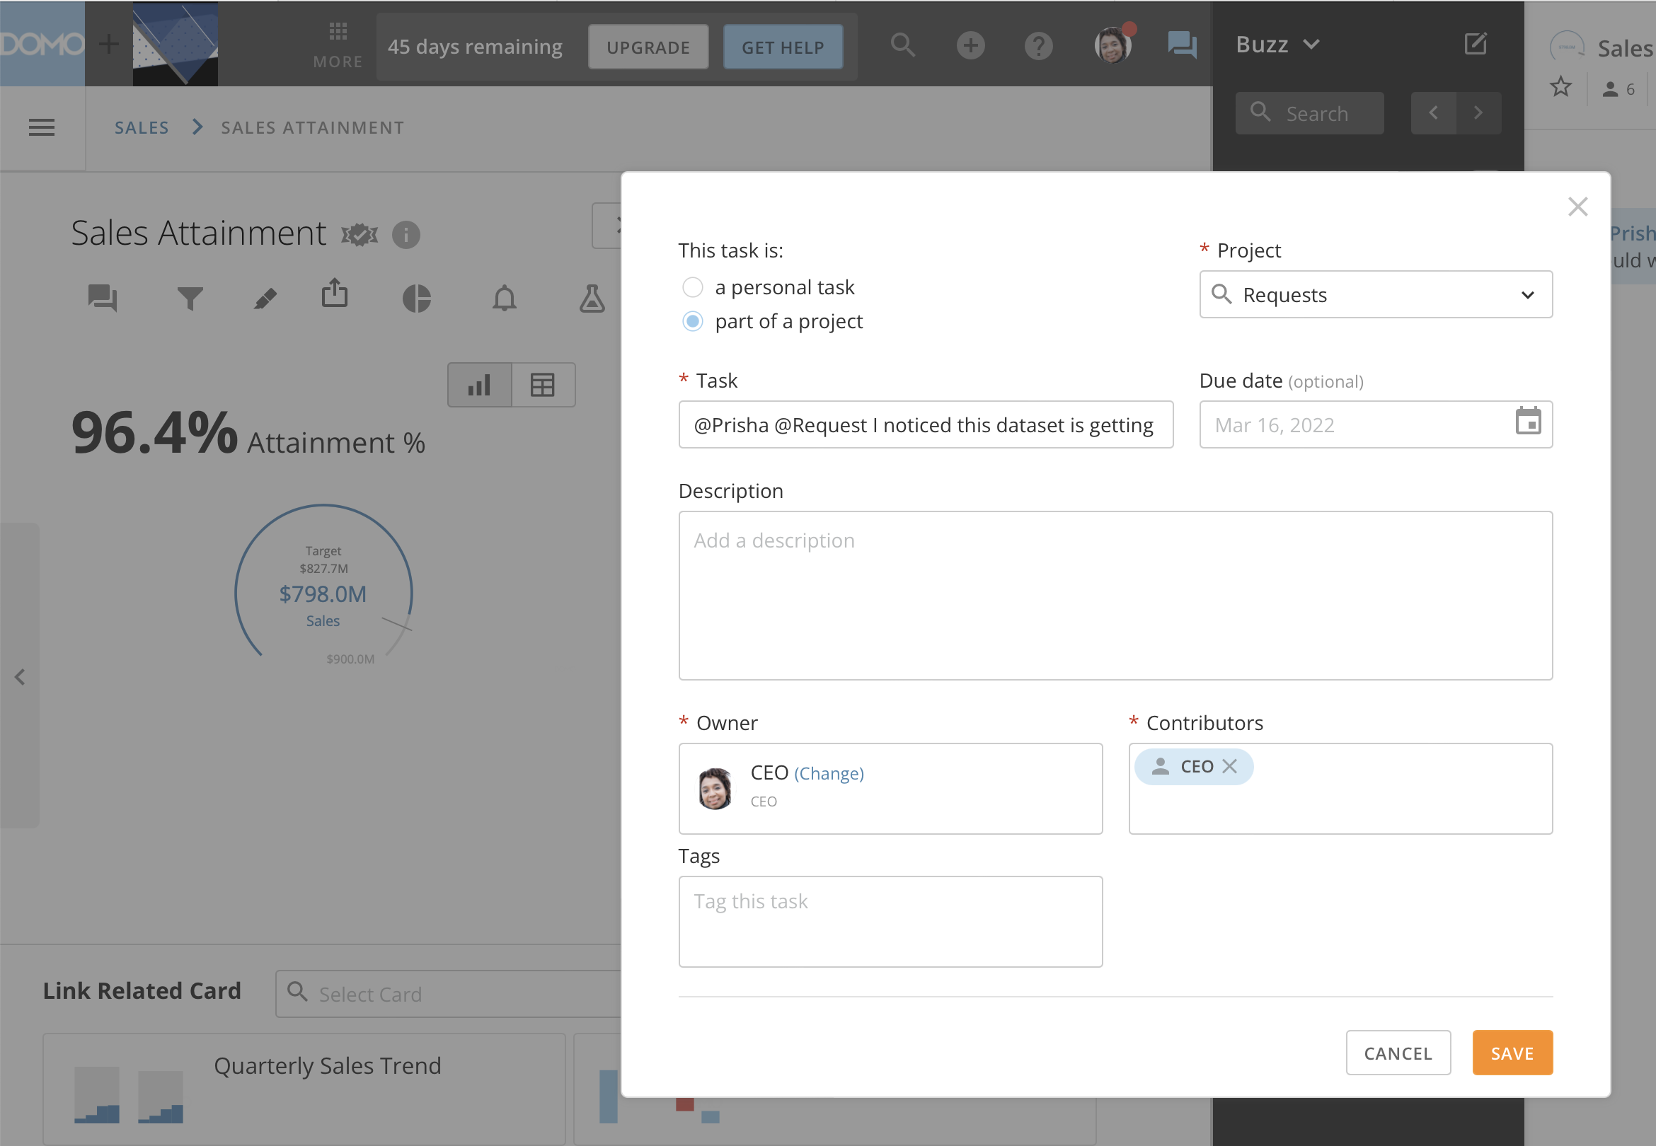

Slide 30
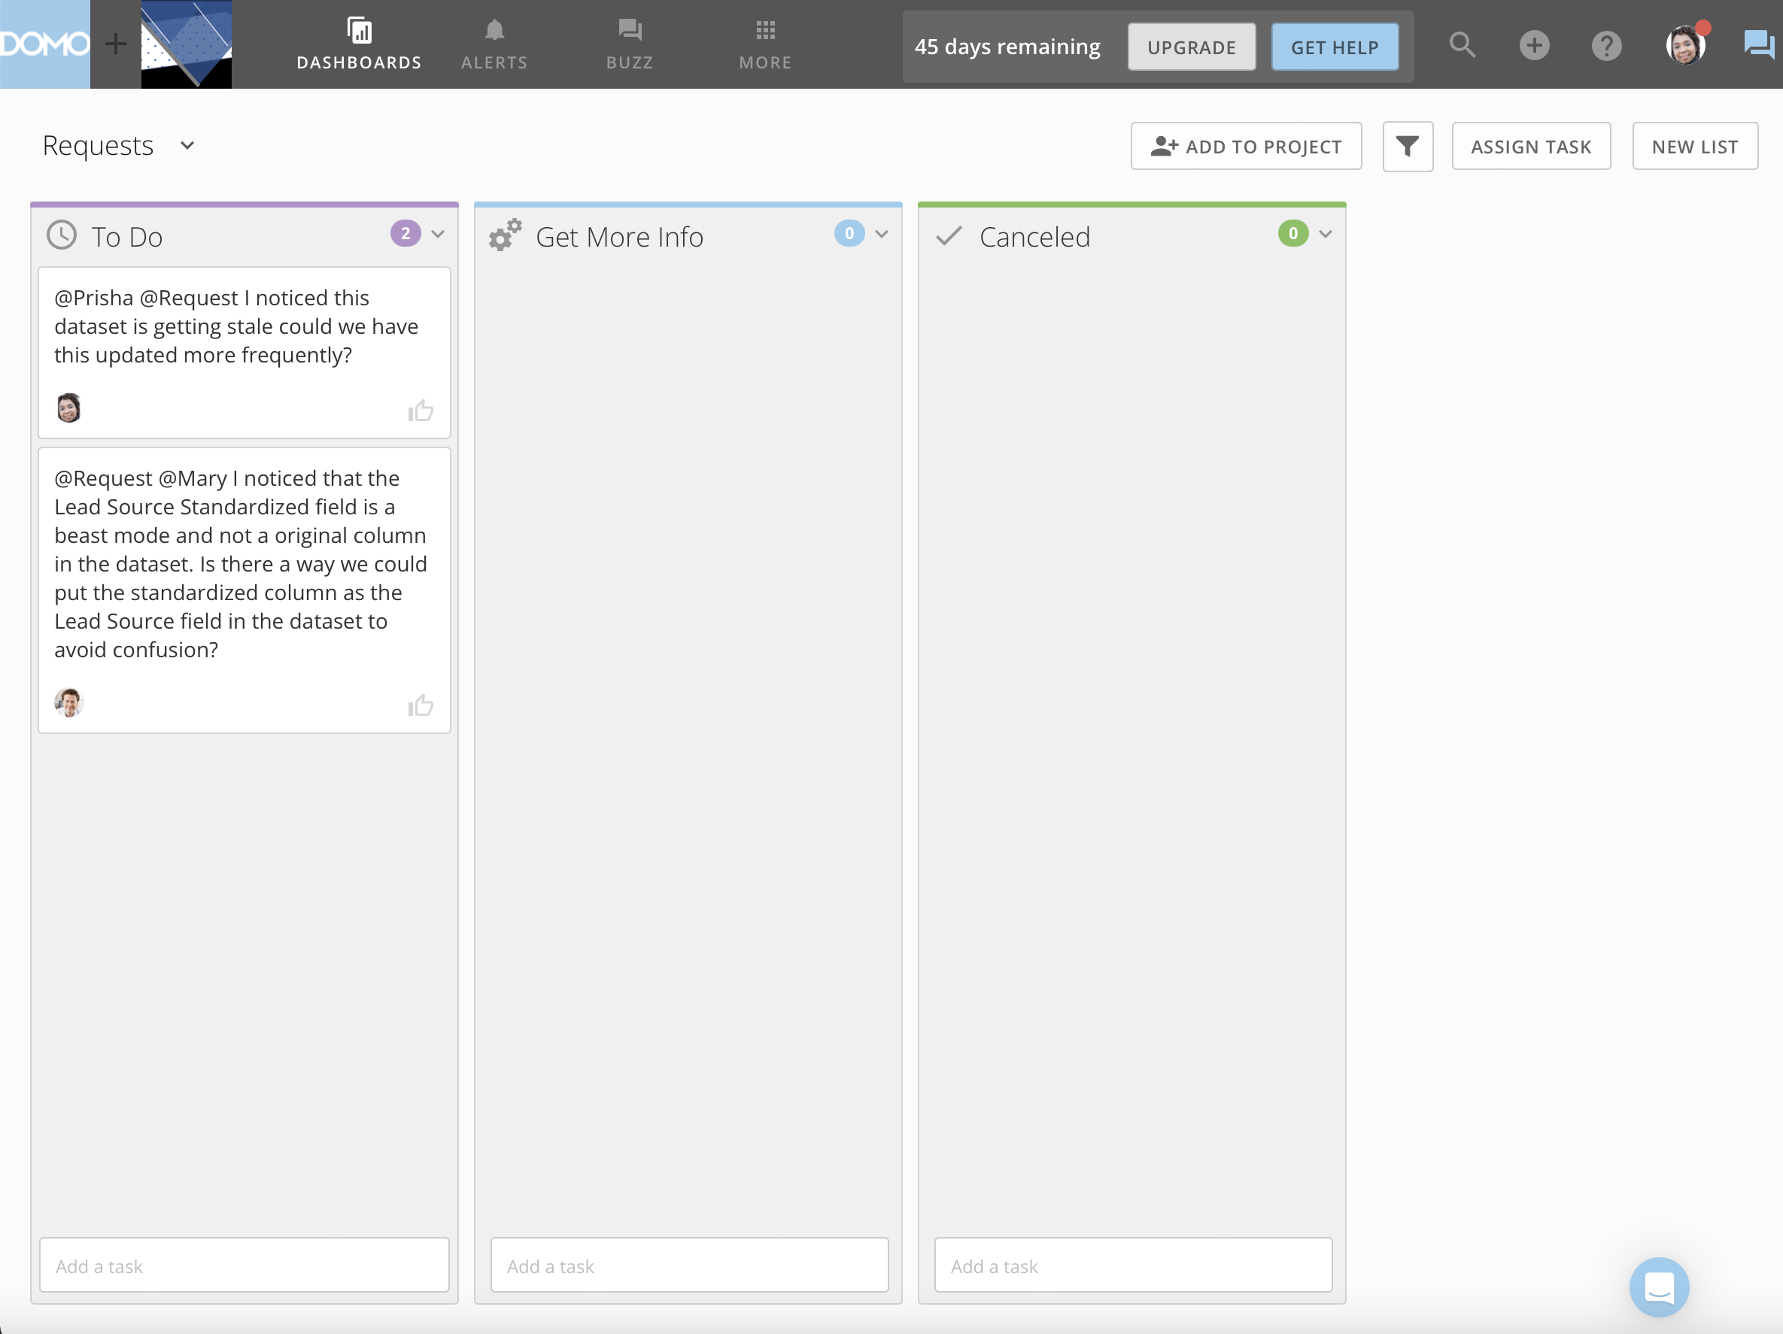

Slide 31
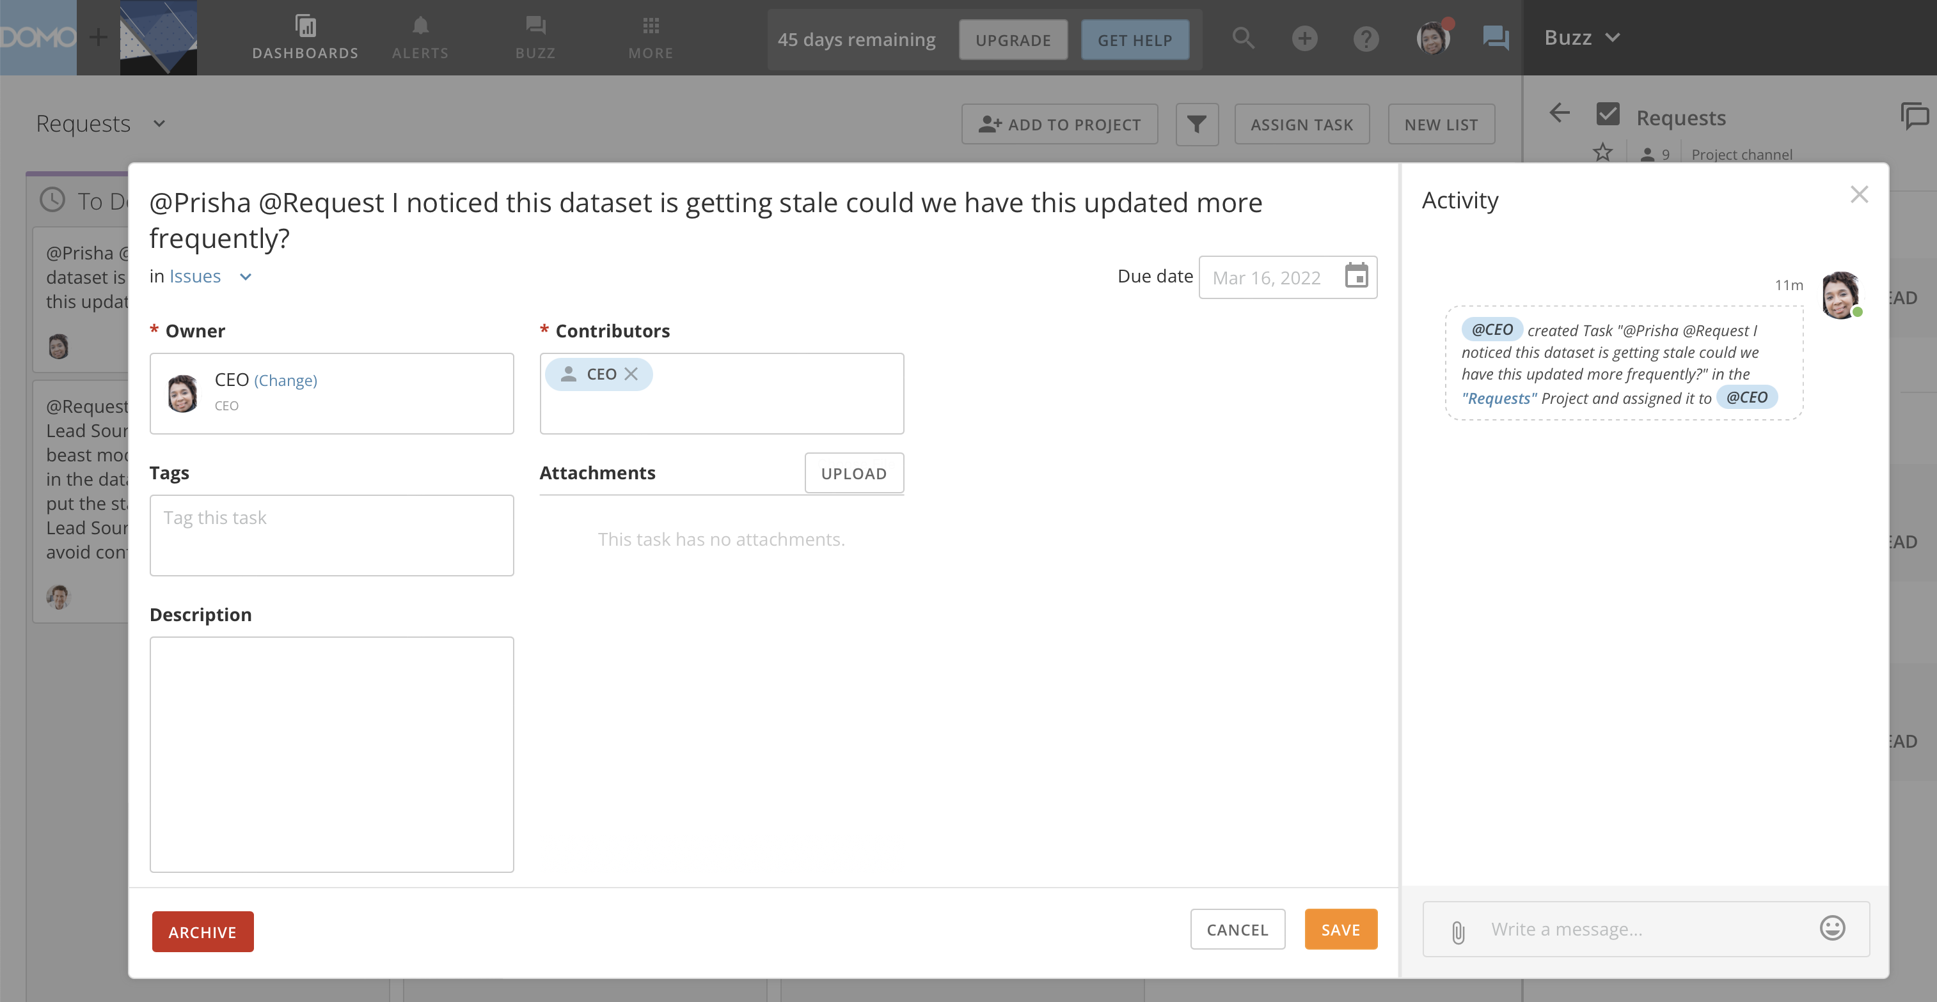

Slide 32
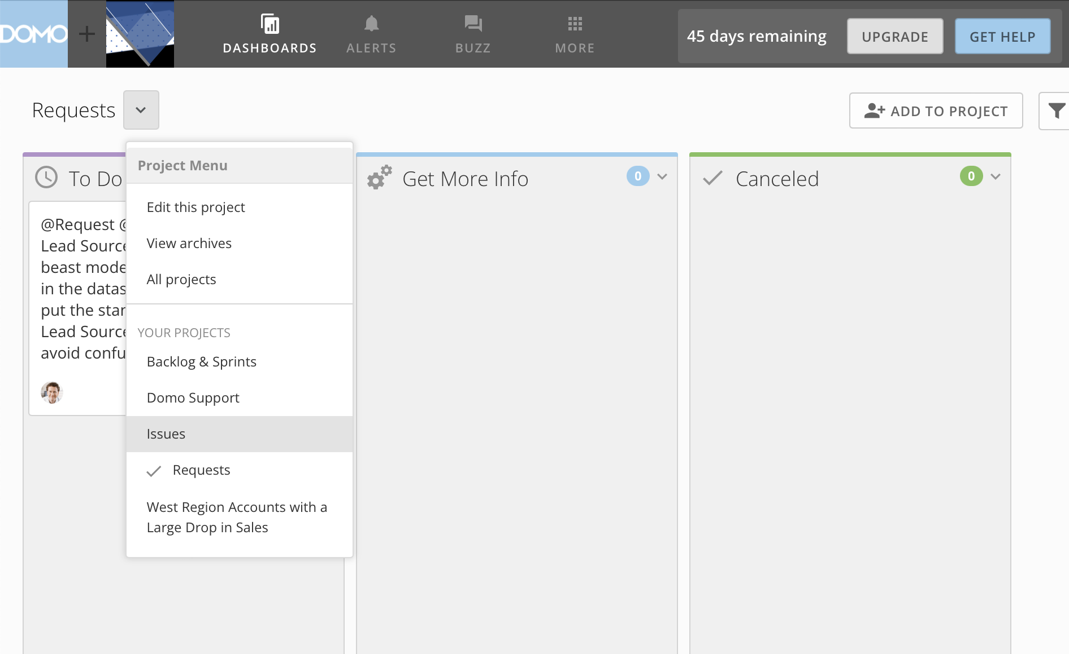

Slide 33
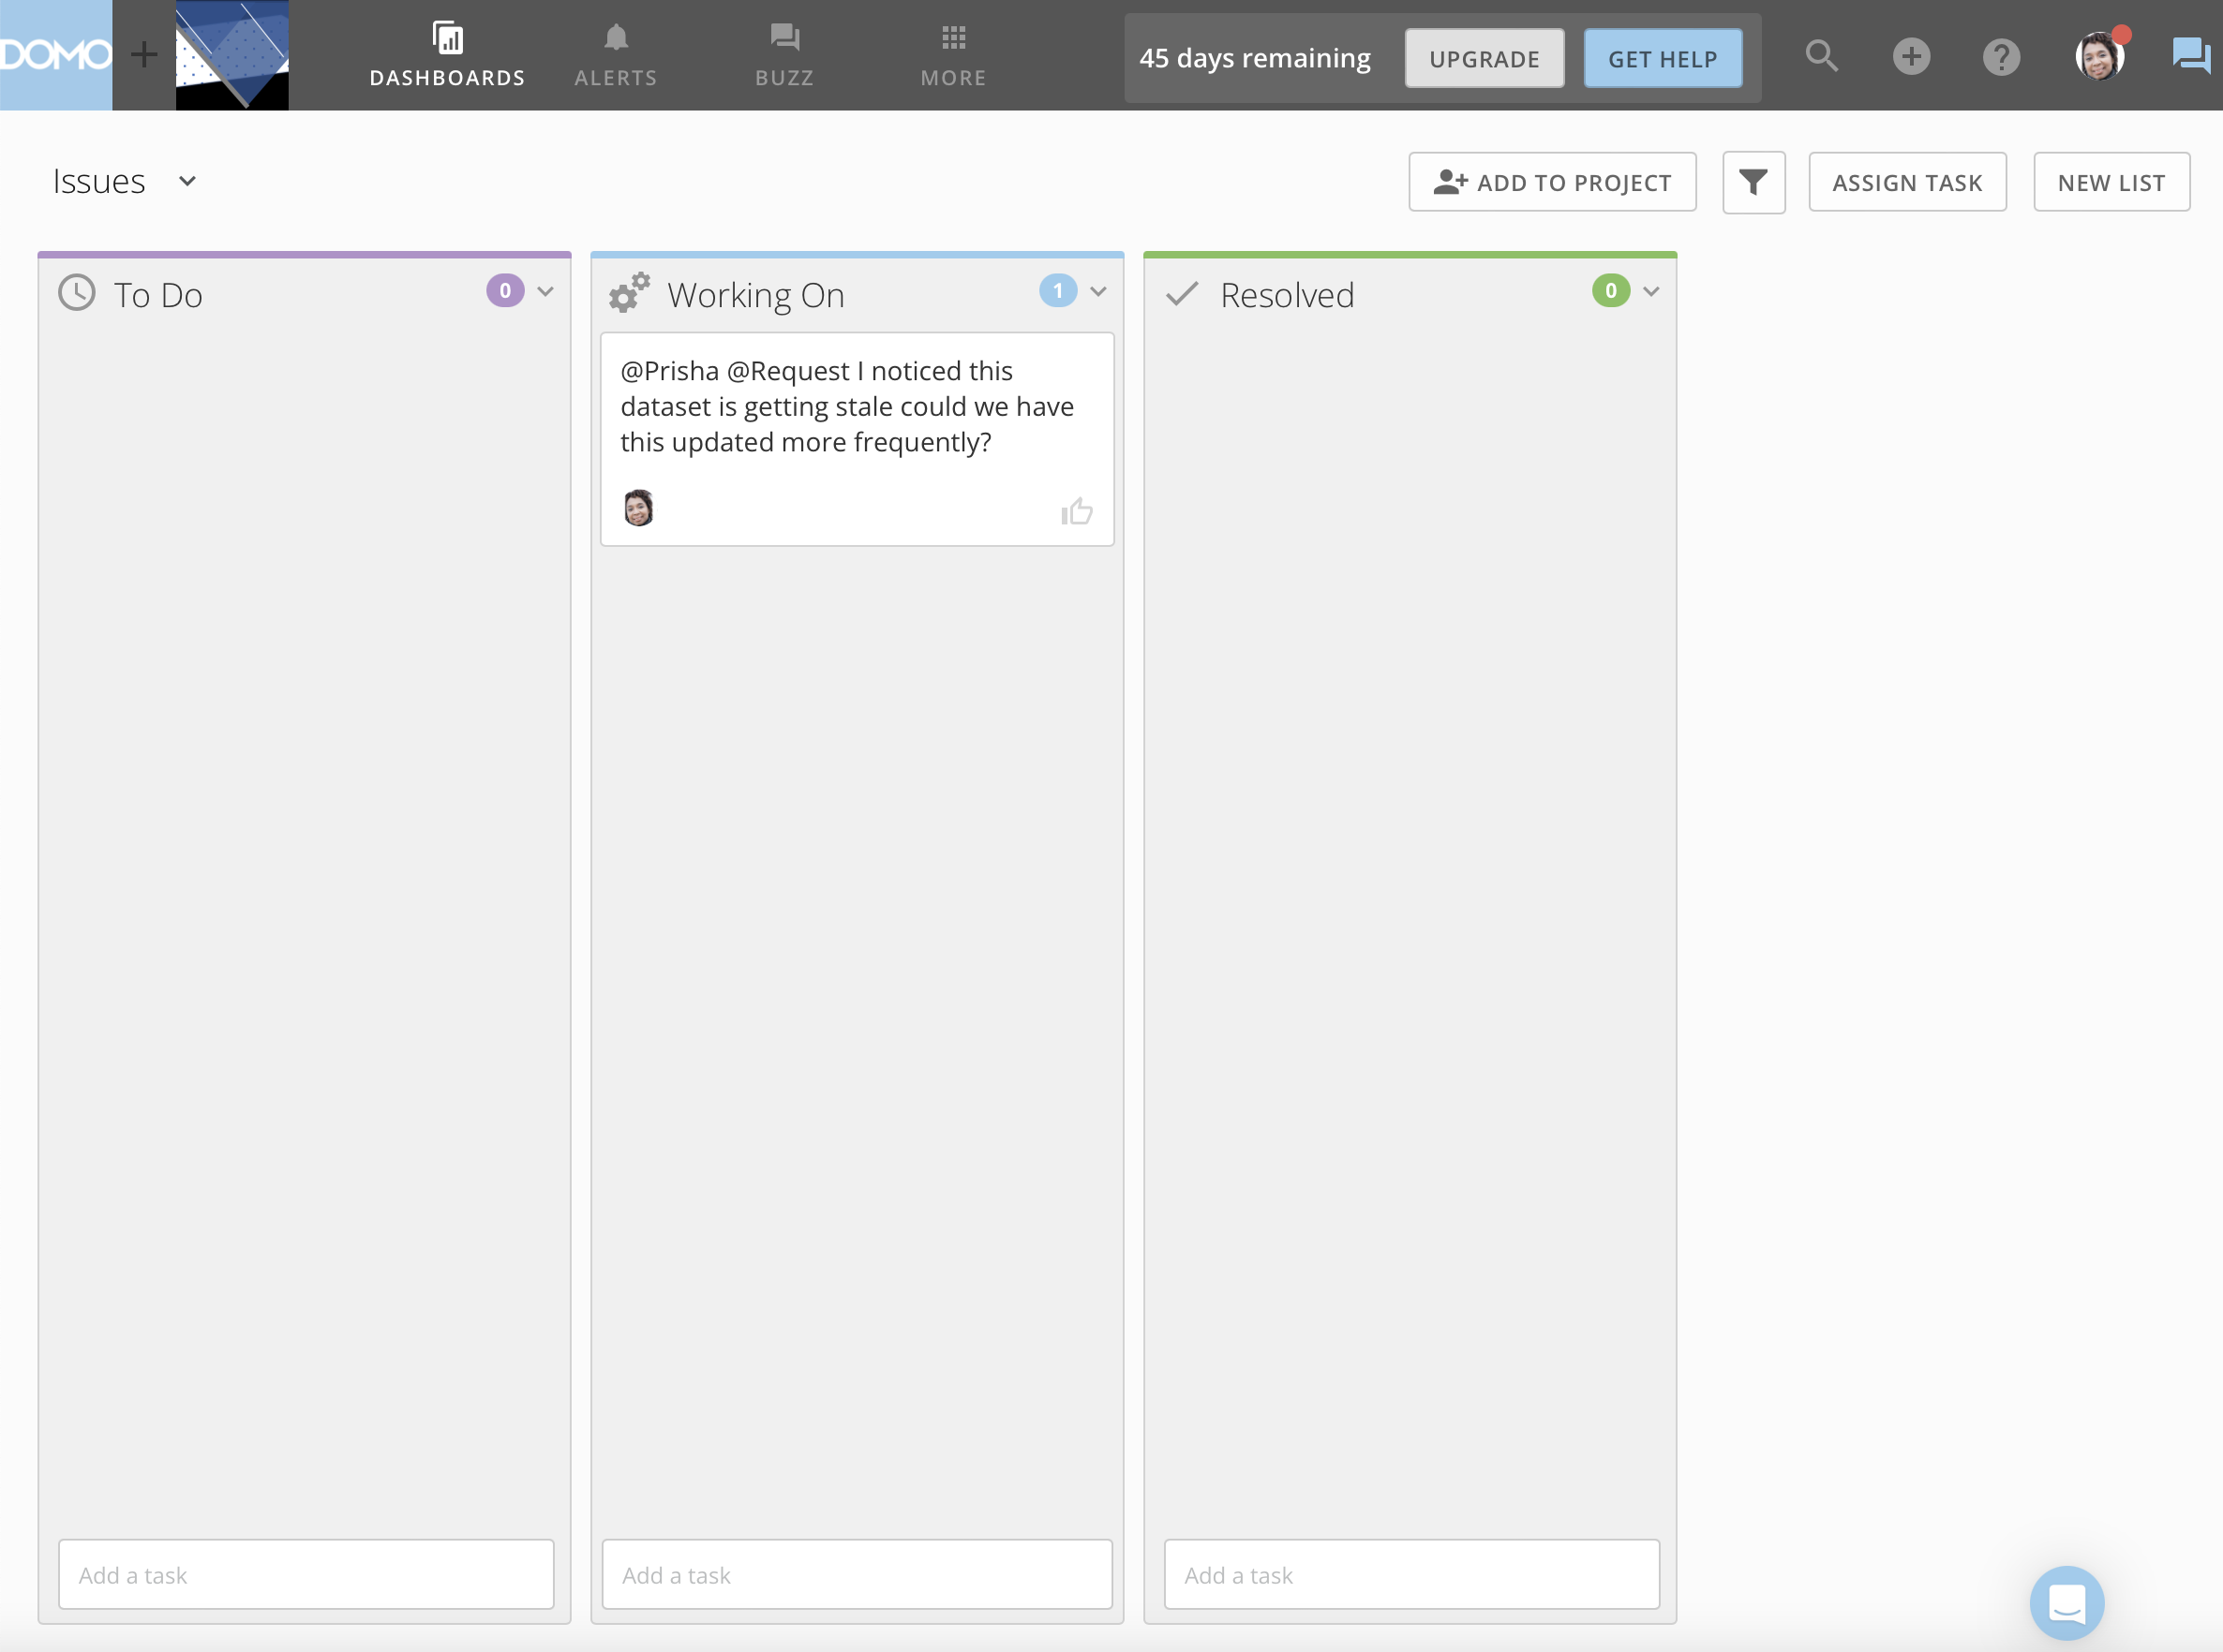

Slide 34
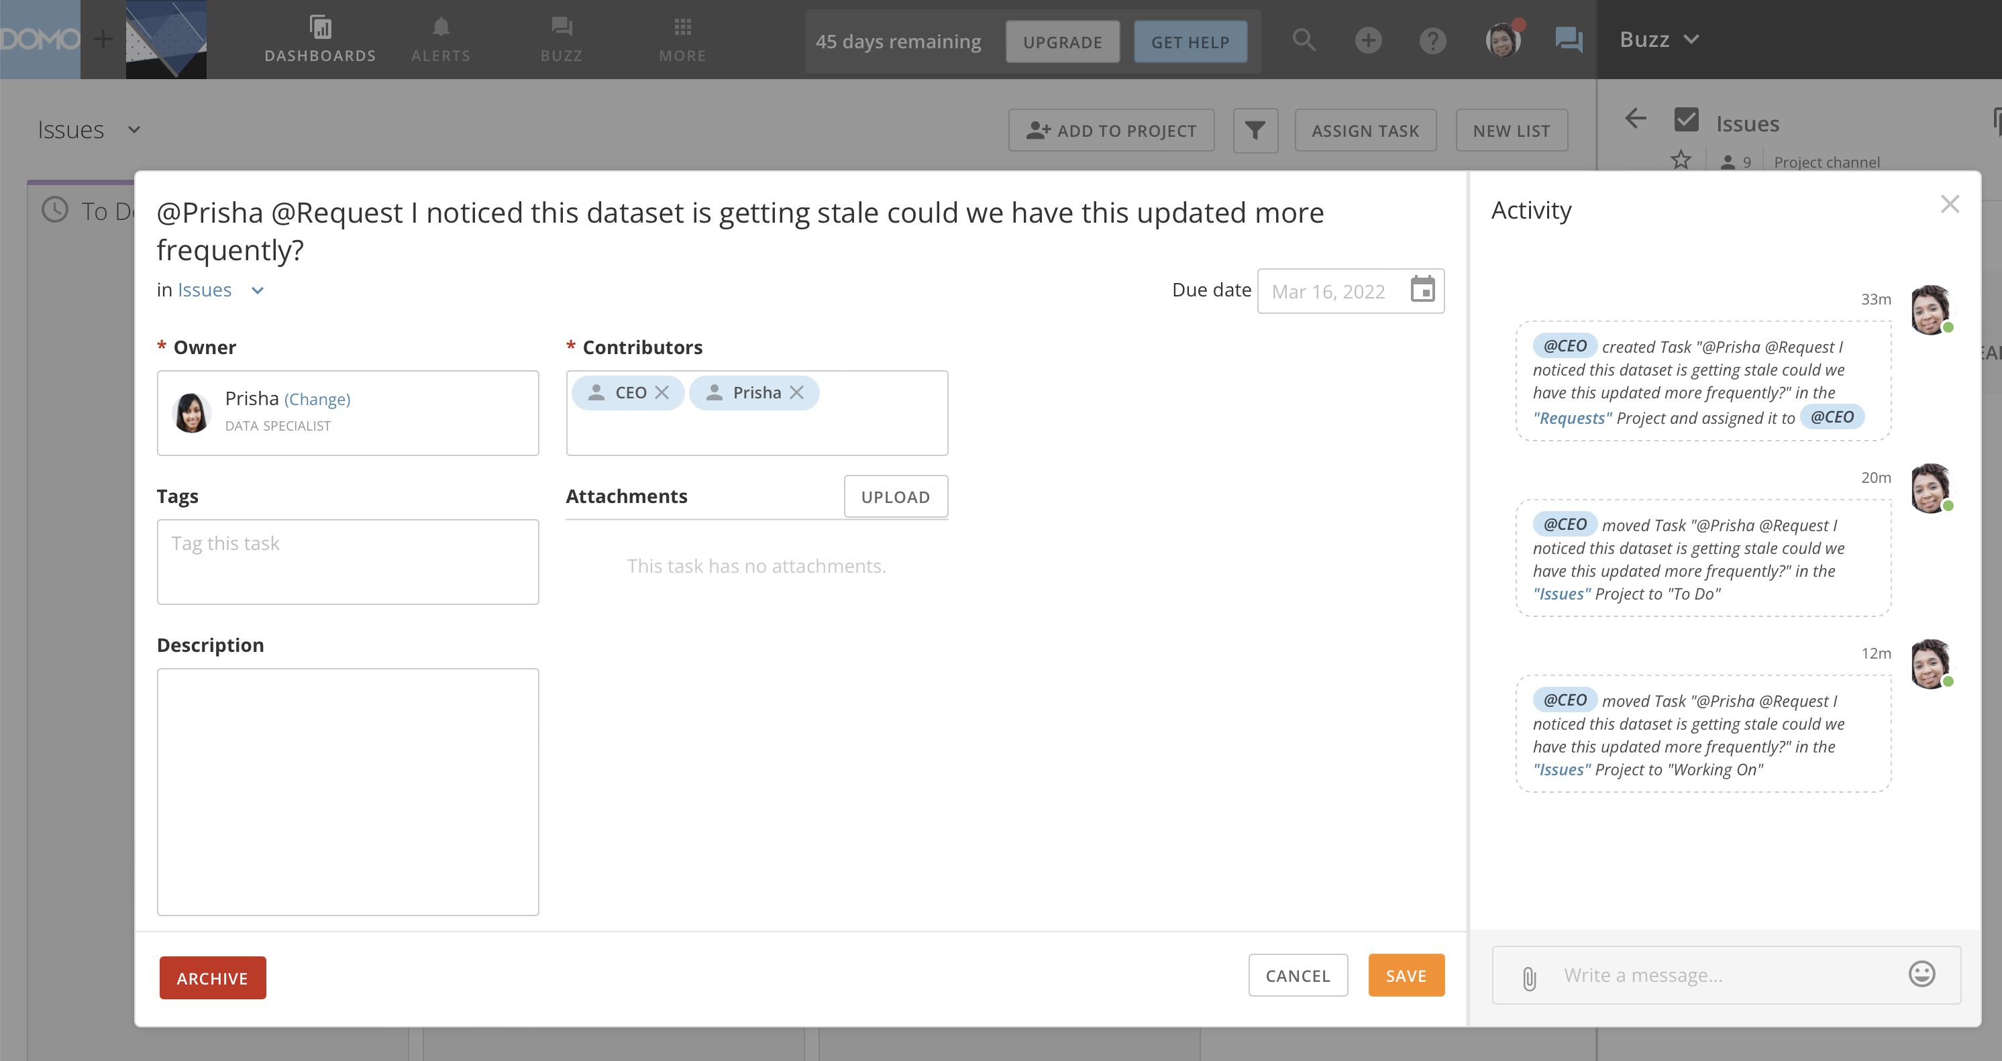

Slide 35
Characteristic | Risk | Full Stack Migration | Card Versioning | DataFlow Versioning
Street Financial Reporting | Misstating Financials Impacts on Public Stock Price | ✔
Sales Compensation | Over/Under Pay | ✔
Marketing Analytics | Miss Allocation of Funds |  | ✔ | ✔
Operational Monitoring | Temporarily Compromised Diagnostics |  | ✔ | ✔
Department KPIs | Temporarily Compromised Analysis |  | ✔ | ✔
Changing Column Names in a Key Dataset | Artifact Breakage that may be time consuming to fix | ✔

